Slide 1
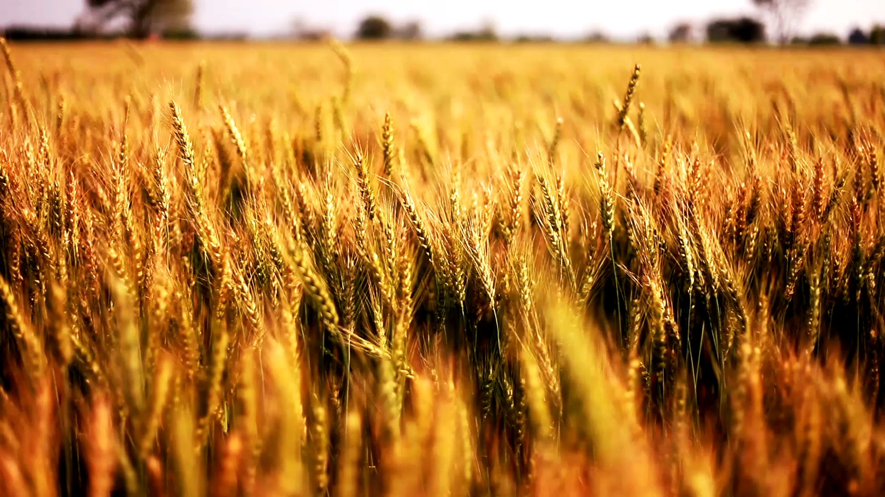
Feeding TLB

Slide 2
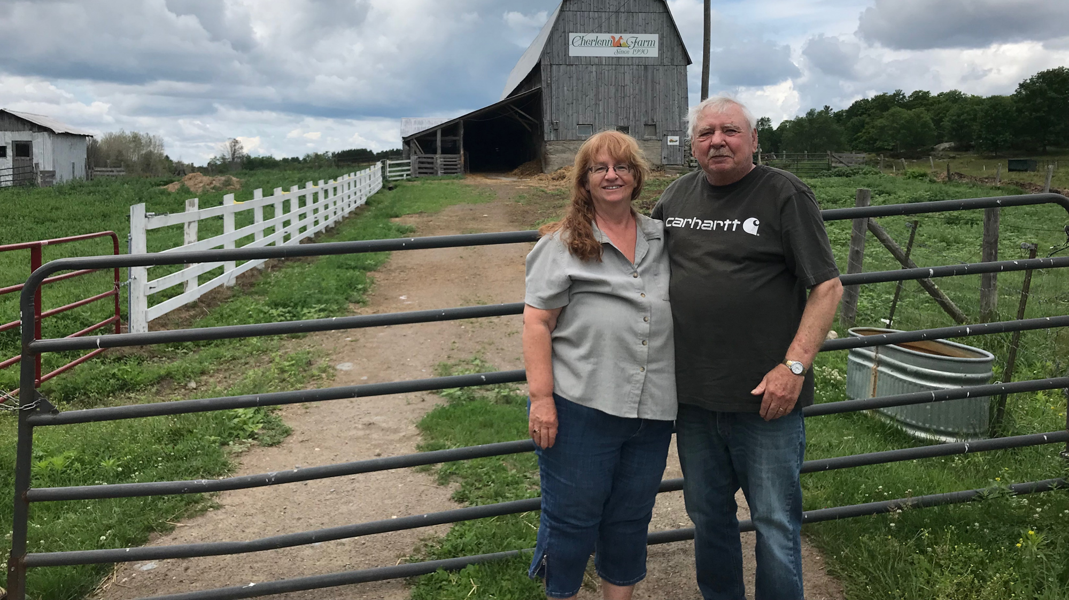
Farmers of TLB

Slide 3
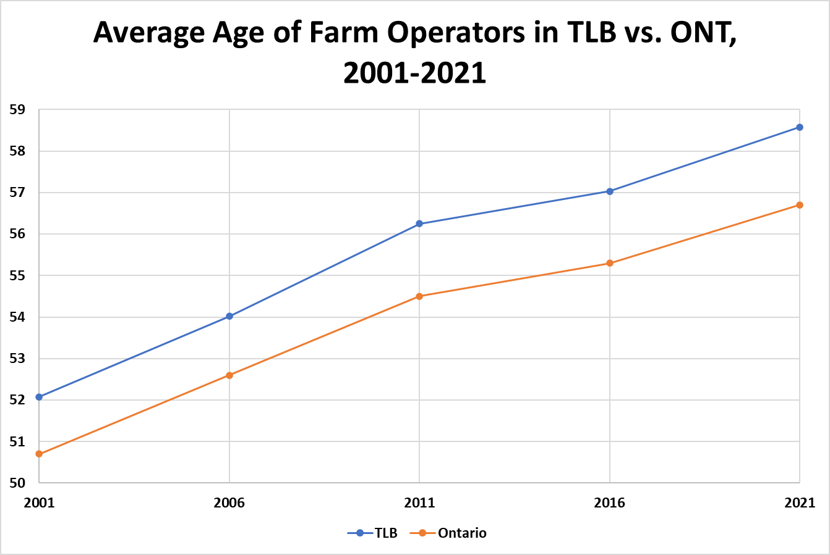
Age of Farmers/Farm Operators

Slide 4
Age of Farmers/Farm Operators Analysis
Farmers in TLB are older than other farmers in Ontario by about 2 years on average (58.58 vs. 56.7).
Average farm operator age has increased faster in TLB than Ontario for each analyzed census period, other than 2011 to 2016 (no recruitment of new farmers)

Slide 5
Age of Farmers/Farm Operators Analysis
Average age of farm operators in individual regions of TLB ranges from over 54 years, to just below 64 years.
Minden Hills (54.6) and Tyendinaga (55.6) had the youngest operators, on average in 2021, while all other TLB regions average operator age was 57.6 or above in 2021

Slide 6
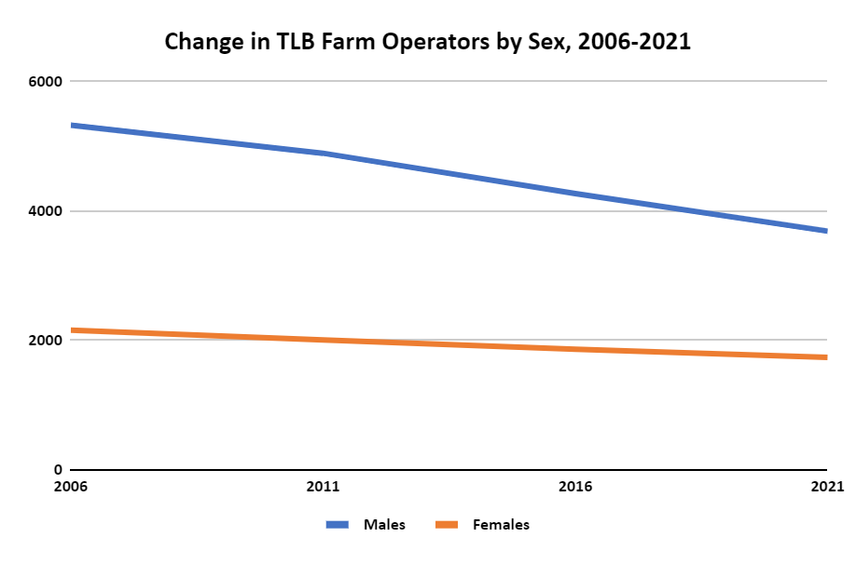
Male and Female Farm Operators in TLB

Slide 7
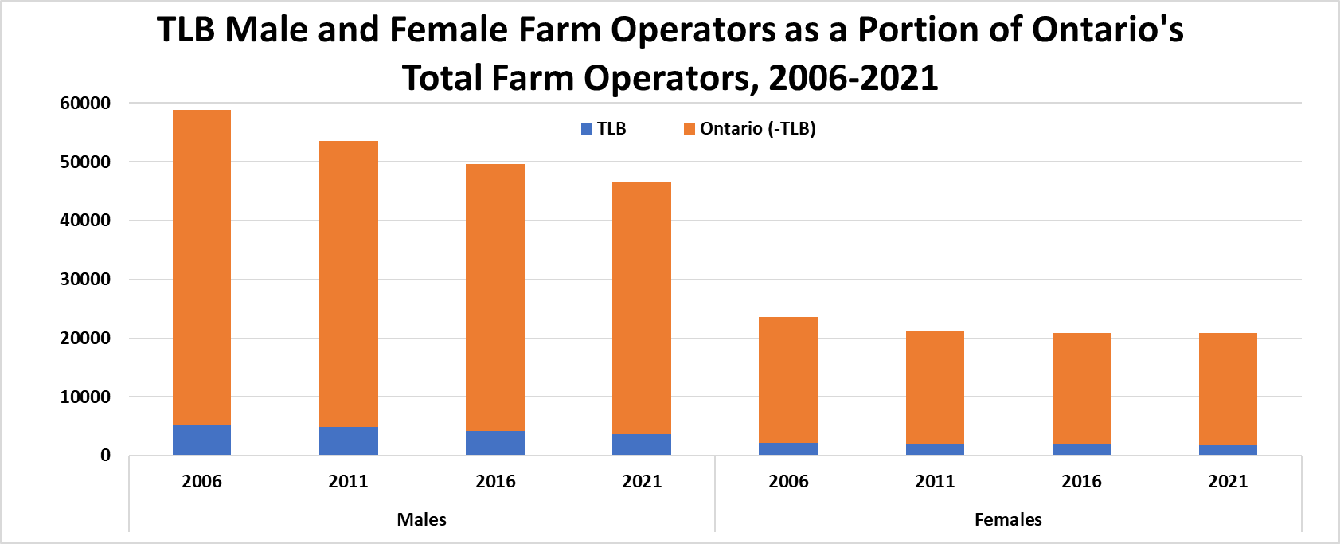
Male and Female Farm Operators in TLB

Slide 8
Male and Female Farm Operators in TLB analysis
Male operators declined faster than female operators:
From 2016-2021 TLB decreased by 13.6% of its male operators, but just 6.72% of its female operators.
Bracebridge had more female farm operators than male operators as of 2021.
Bancroft had approximately the same.
Minden Hills had just 5 fewer female operators.

Slide 9
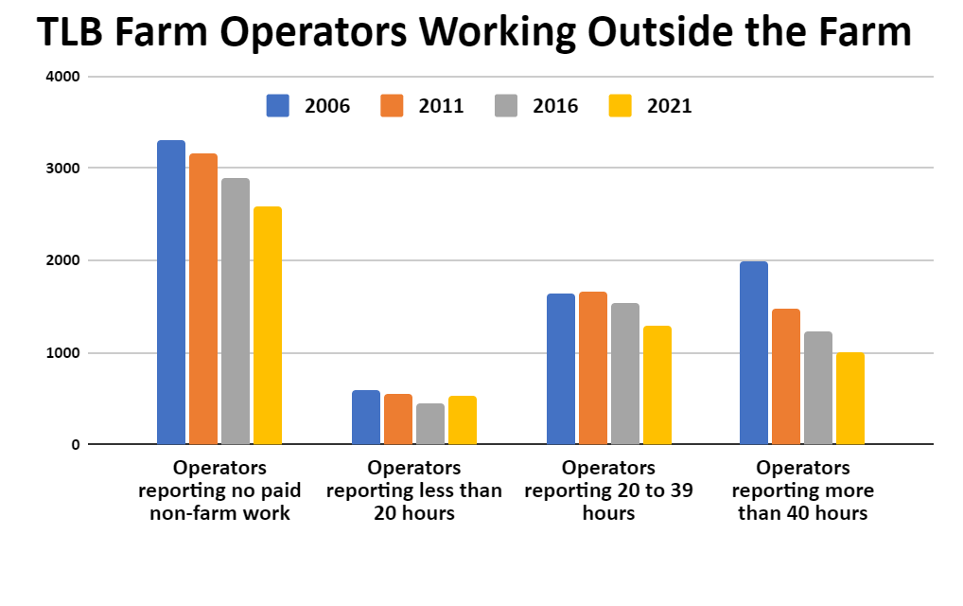
Off-Farm Employment
*“Farm operator is defined as to those persons responsible for the management decisions in operating an agricultural operation”

Slide 10
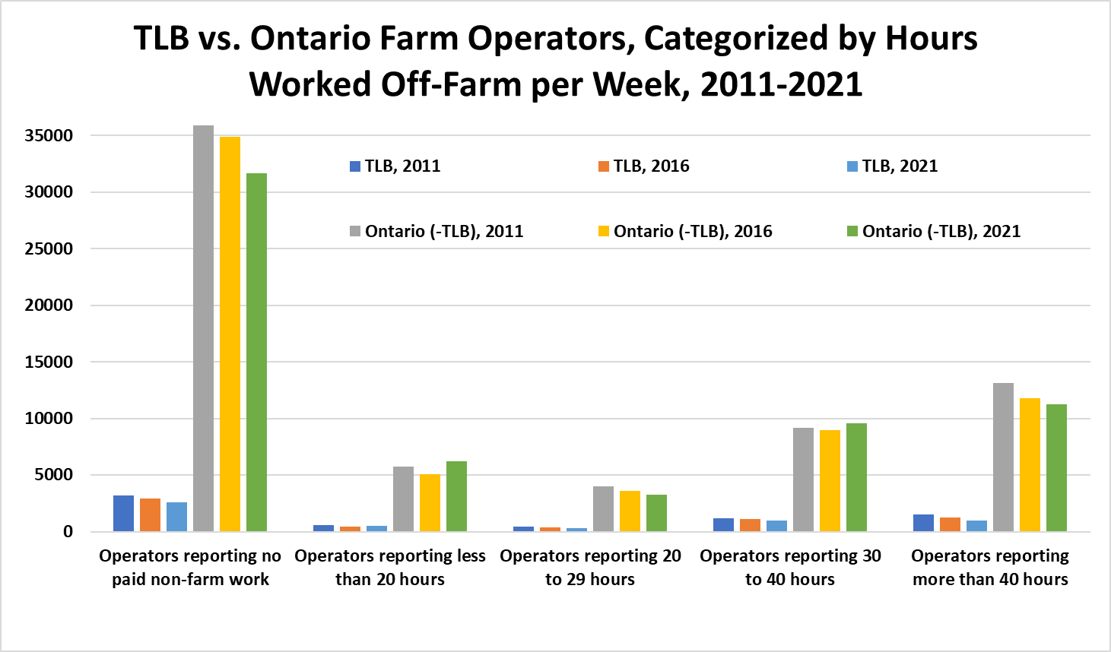
Off-Farm Employment
*“Farm operator is defined as to those persons responsible for the management decisions in operating an agricultural operation”

Slide 11
Off-Farm Employment
Farms are more lucrative or farms are sustainable?
Similar trends In TLB compared to those seen in Ontario as a whole
Largest proportion of farm workers do not have another paid job
50% decline in the number of operators working more than 40 hours a week off-farm, from 2006-2021

Slide 12
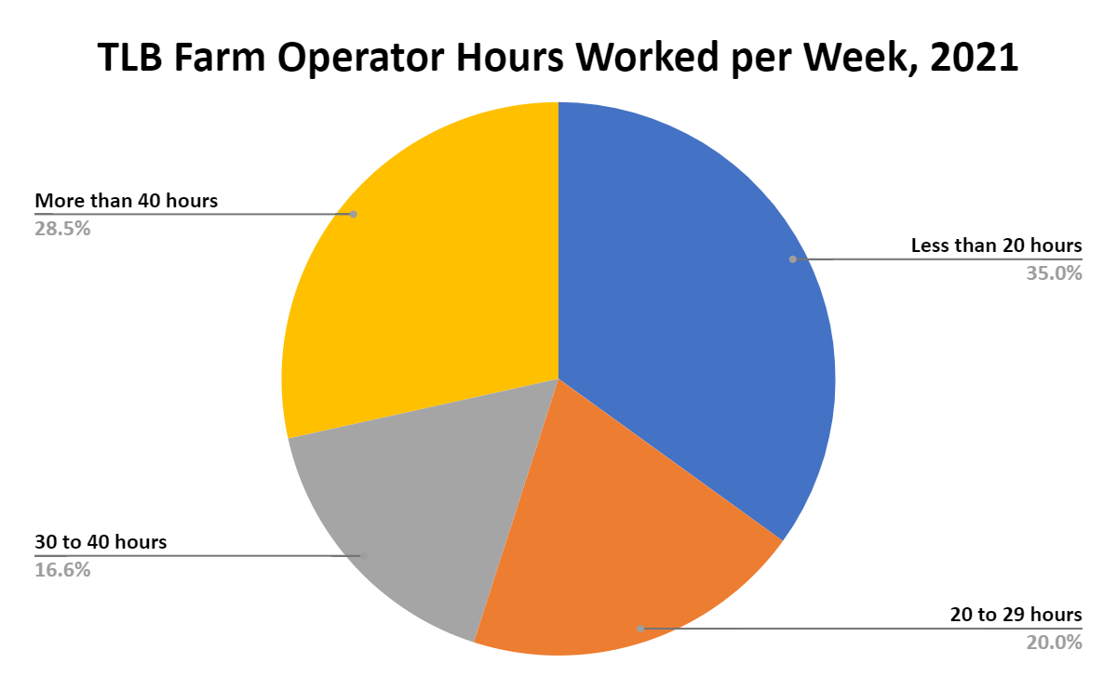
Hours per Week Farming

Slide 13
Hours per Week Farming
55% of farmers in TLB spent less than 30 hours a week farming in 2021
The largest total in TLB for 2021 was operators working 20 hours or less, at 35% of all operators
TLB is declining at a similar rate to Ontario overall in operators working 30-40 hours, or 40+ hours…
But, TLB is declining more rapidly in operators working less than 20, or 20-29 hours per week: TLB accounted for 75% of the provincial decline in operators working less than 20 hours per week from 2016 to 2021
Farmers retiring on their farms

Slide 14
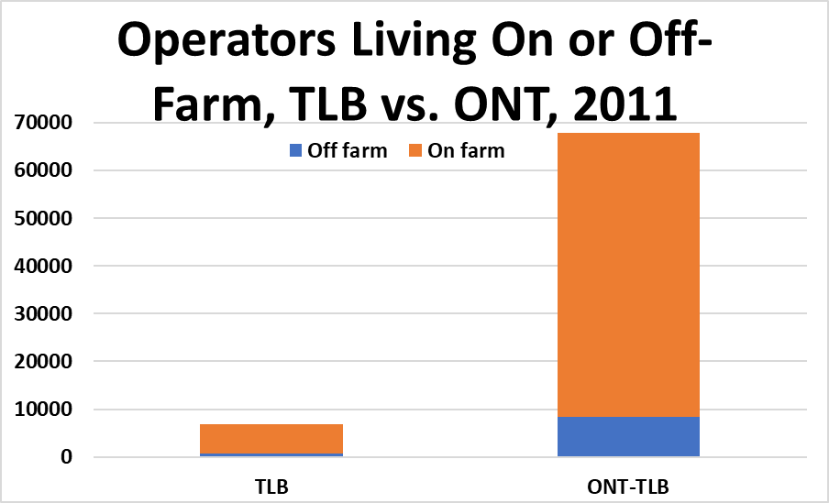
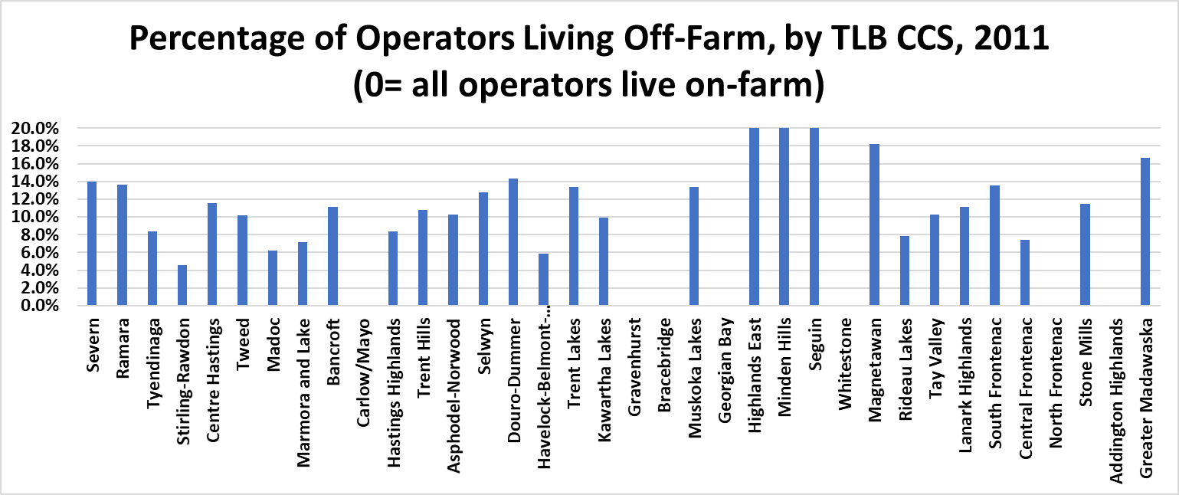
TLB Farm Operator Residence Location

Slide 15
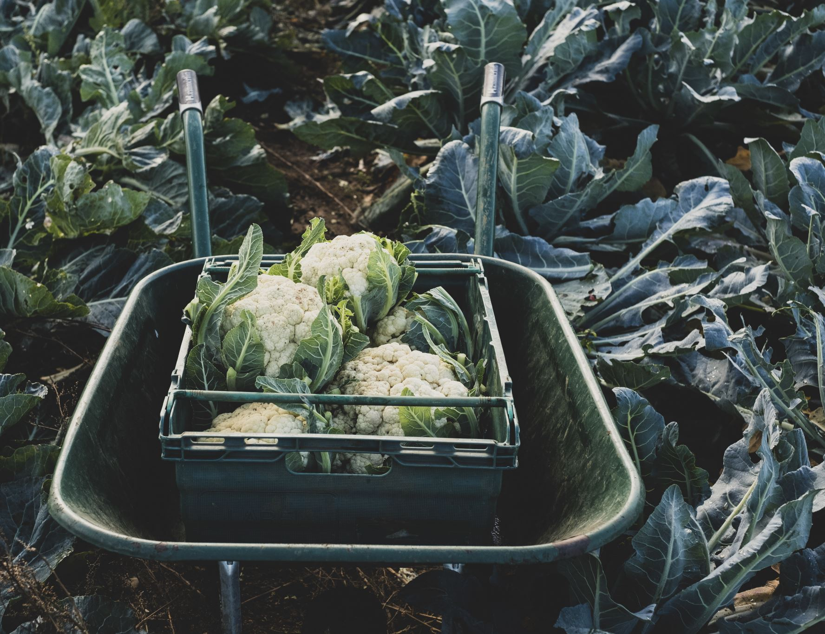
Farm Products of TLB

Slide 16
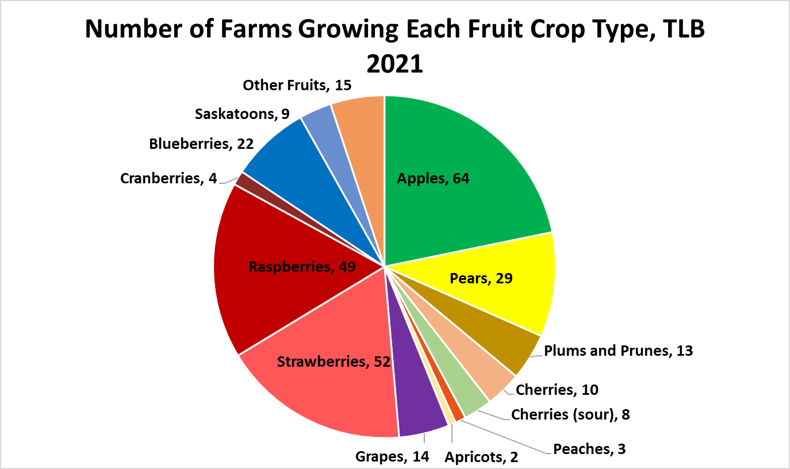
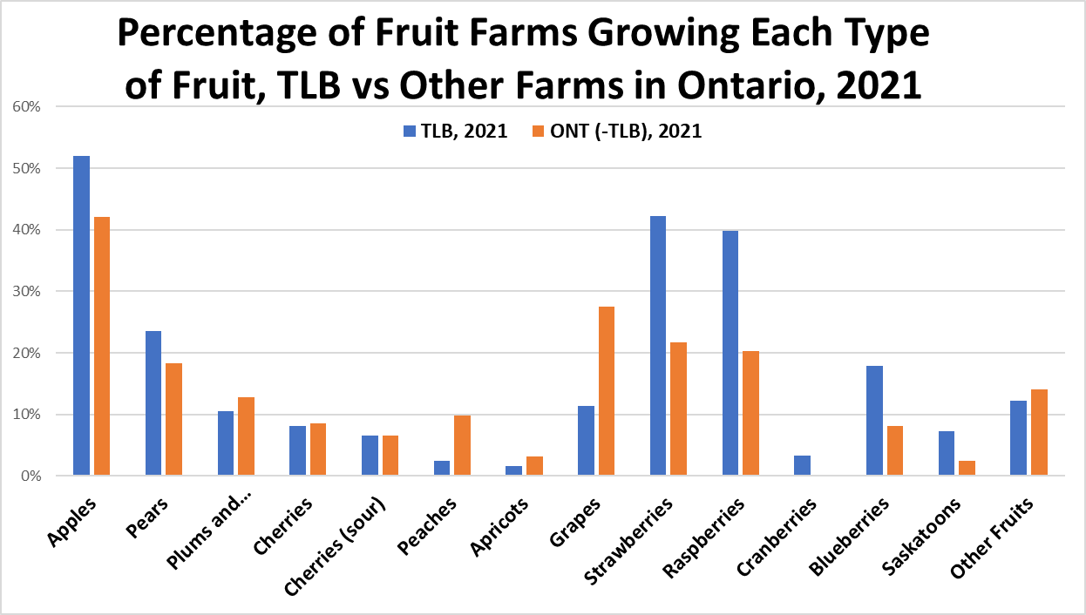
Fruit Crops

Slide 17
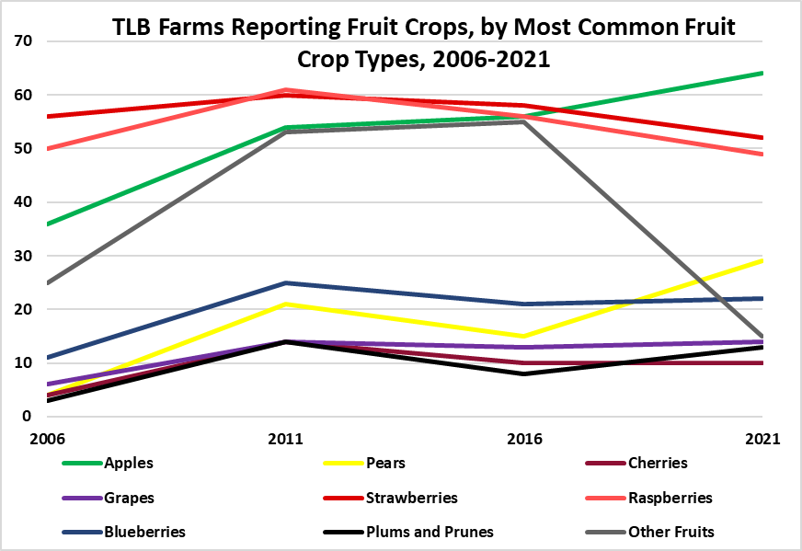
Fruit Crops

Slide 18
Fruit Crops
Apples, strawberries, raspberries most commonly grown fruit crops in TLB, with apples rising from 3rd to most common, between 2006-2021
Fruit farms in TLB tend to grow more than one type of fruit
2016-2021 there was a sharp decrease in farms growing “other fruit”
TLB home to 10-11% of Ont. farms growing blue/rasp/straw-berries in 2021, and 4 of 9 (44.4%) farms growing cranberries

Slide 19
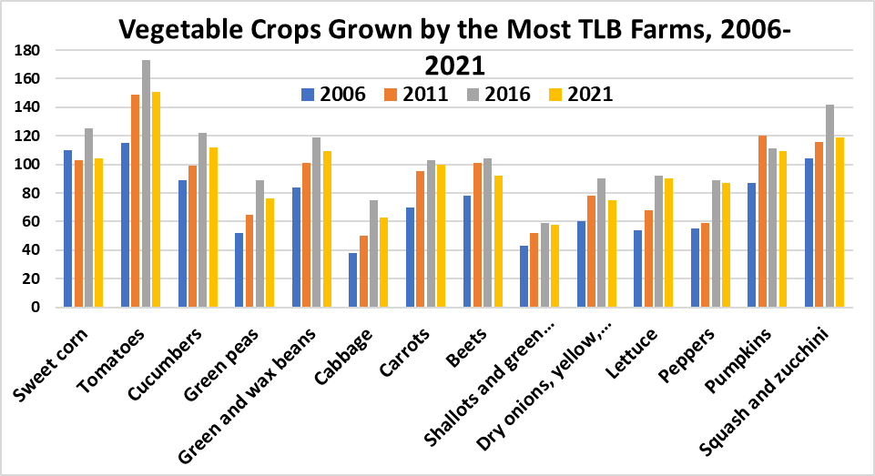
Vegetable Crops

Slide 20
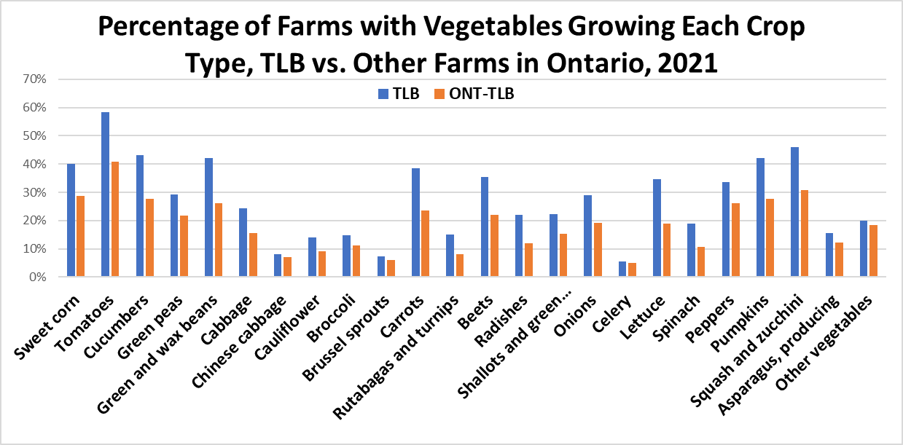
Vegetable Crops

Slide 21
Vegetable Crops
2006-2016 TLB increases in the % of farms growing: sweet corn, tomatoes, cucumber, green peas, green and wax beans, cabbage, carrots, beets, shallots, onions, celery, and zucchini and squash
only decrease between 2006 and 2021 number was sweet corn
However, from 2016-2021 all of the above crops saw decreases

Slide 22
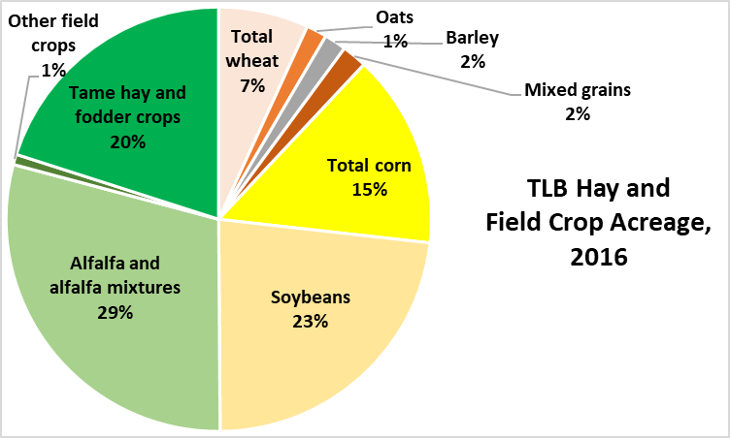
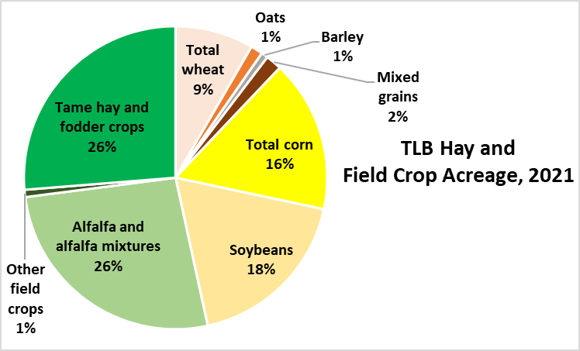
Hay and Field Crops

Slide 23
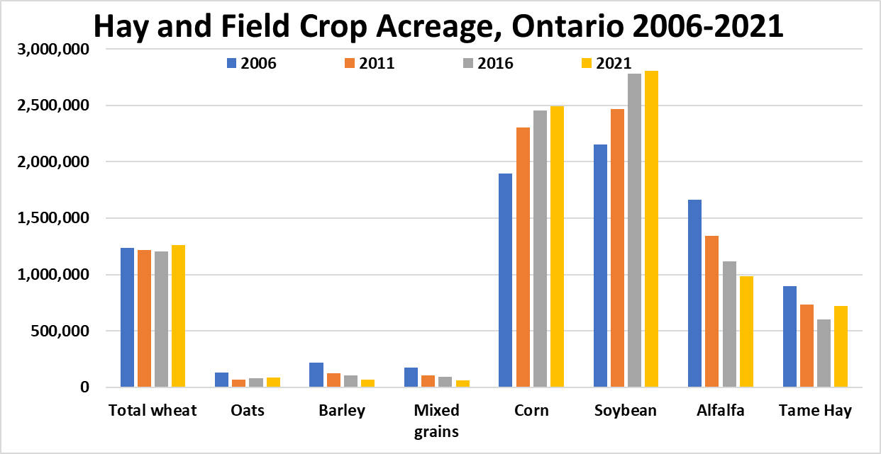
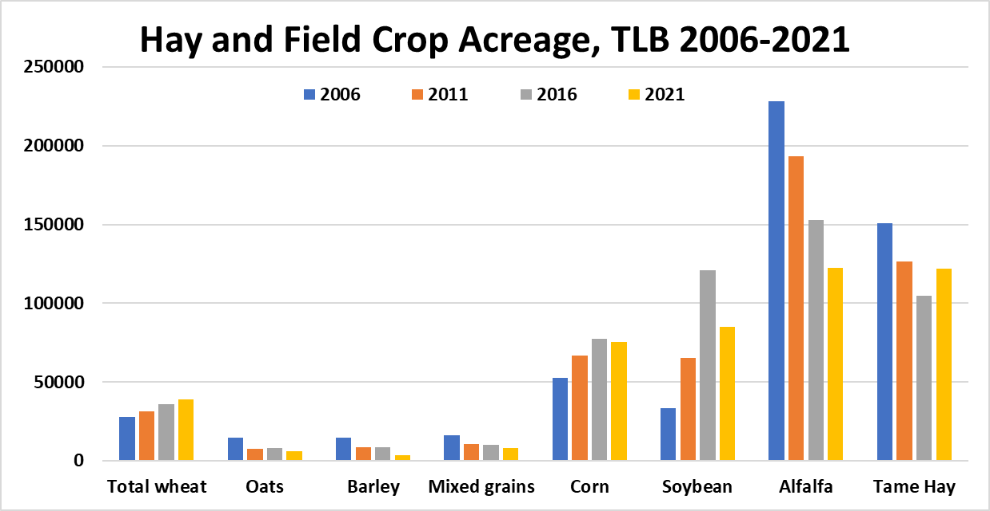
Hay and Field Crops

Slide 24
Hay and Field Crops (HAFC)
Tame hay/alfalfa have long accounted for the largest acreage totals in TLB of HAFC crops, but alfalfa production has been steadily declining (faster than ONT), and tame hay acreage dropped below that of soybeans in 2016, before rebounding by 2021, while soybean acreage declined.
Total wheat acreage in TLB has risen each census period, from 2006-2021 (28,000 to 38,000 acres)
Field corn was 4th largest, though its acreage total declined from 2016-2021 (77,000 to 75,500 acres)
Barley, oats and mixed grains are being grown less, but rye has grown from 38 farms reporting in 2011, to 117 in 2021 (and nearly 860% growth in acreage)

Slide 25
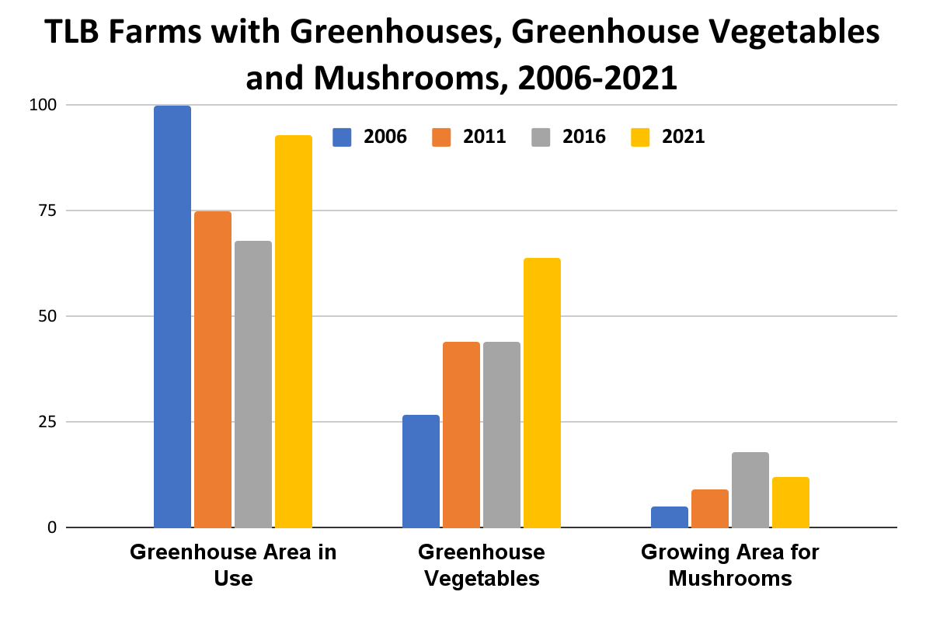
Greenhouse Vegetables and Mushrooms

Slide 26
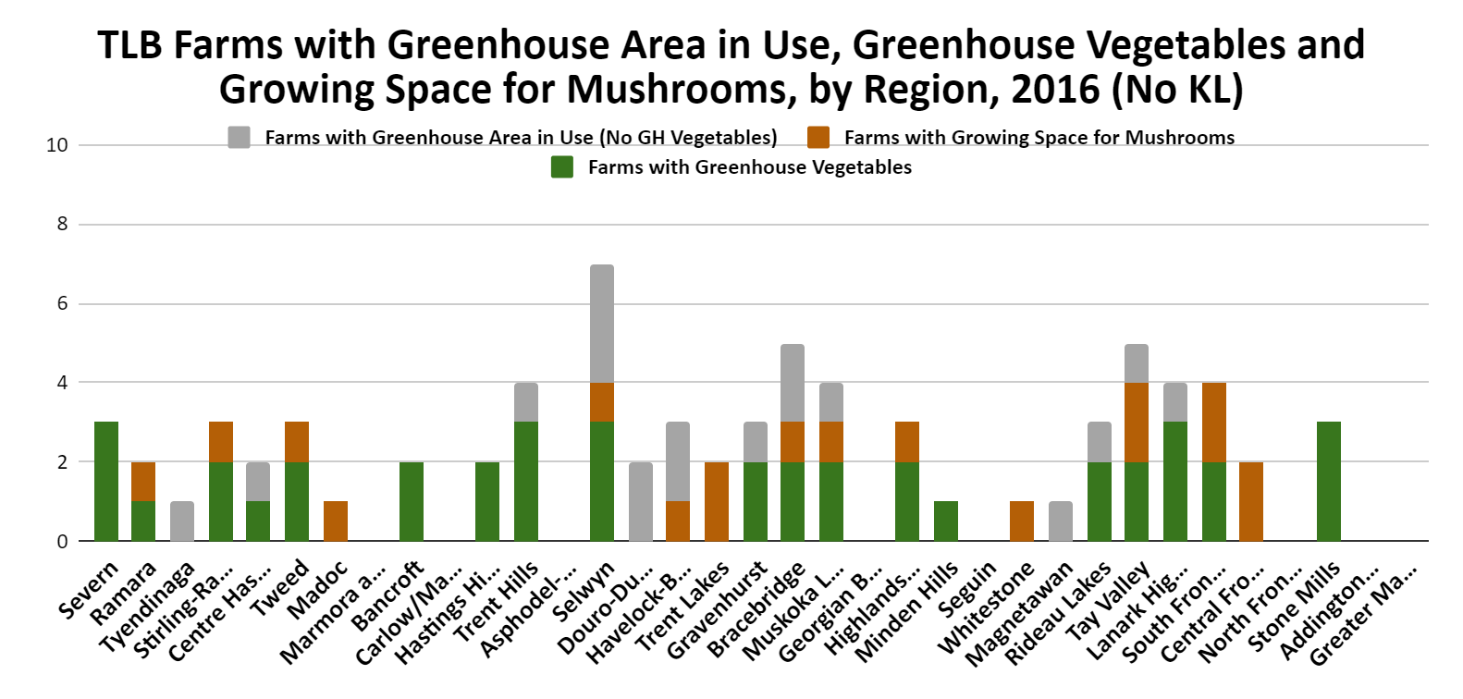
Greenhouse Vegetables and Mushrooms

Slide 27
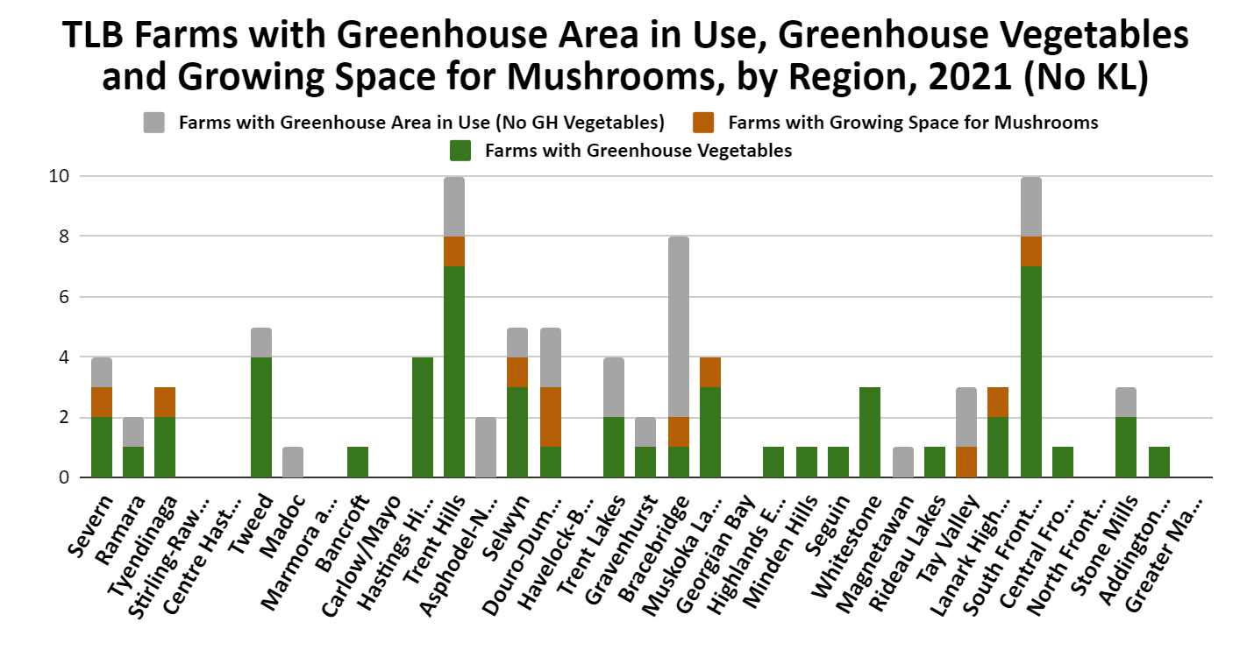
Greenhouse Vegetables and Mushrooms

Slide 28
Greenhouse Vegetables and Mushrooms
Mushroom production increased in TLB from 2006-2016 (despite declines in Ontario overall. However 2016 to 2021 saw a province wide decline.
TLB with 12 of 89 farms with mushrooms in ONT (2021)
KL (3) and Douro-Dummer (2) only TLB regions with multiple farms with mushrooms in 2021

Slide 29
Greenhouse Vegetables and Mushrooms
52% of farms with greenhouse areas are growing greenhouse vegetables in Ontario (up from 45% in 2016). In TLB 69% as of 2021 (up from 65% in 2016)
Greenhouse vegetables: TLB: 29 farms in 2006, to 46 in 2011, to 56 in 2016, to 64 in 2021. Highest areas: Hastings Highlands, Lanark Highlands, Tweed and Carlow/Mayo
Ontario has grown from 654 to 755 over those 15 years

Slide 30
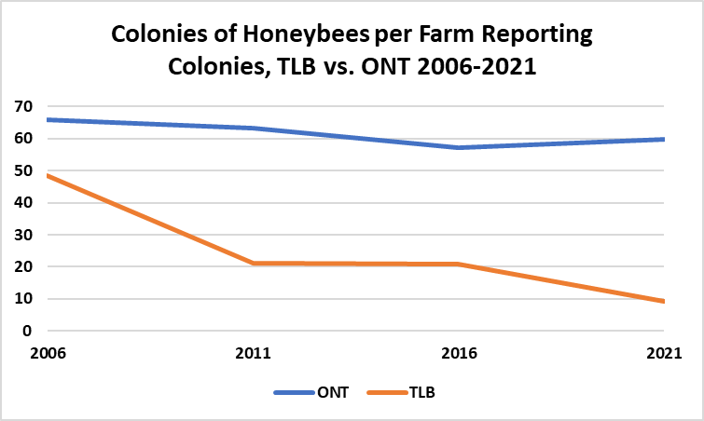
Apiculture

Slide 31
Apiculture
TLB farms with honeybee colonies on the rise from 2001-2016, before declining between 2016 and 2021.
In 2021, there 166 farms reporting, compared to 112 in 2001
TLB dropped more than 50%.
Trent Hills (+12), Selwyn (+9), Ramara (+6) and Kawartha Lakes (+5) had the largest increases in farms reporting colonies of honeybees kept from 2001 to 2021
KL has by far the most farms reporting colonies, with 33 as of the 2021 census.
Severn, Trent Hills, Selwyn, Rideau Lakes, Lanark Highlands and Stone Mills range between 7 and 12 farms reporting colonies each

Slide 32
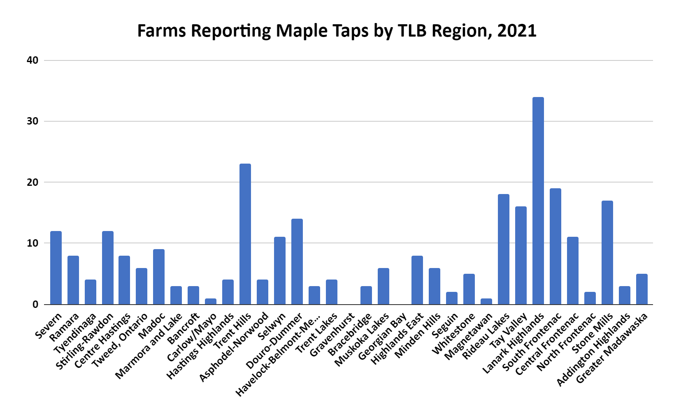
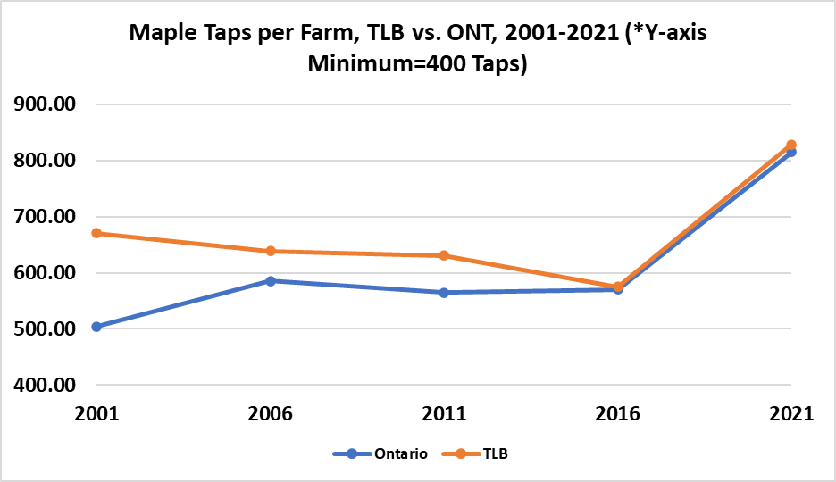
Maple Syrup

Slide 33
Maple Syrup
Maple taps in TLB were steadily on the rise in TLB from 2001-2016 (+33%), with at least 33 new farms reporting taps in each census during that period, before declining by 138 between 2016 and 2021 (-28%)
28% of all new farms with maple taps in Ontario from 2001 to 2016 came from TLB
The most farms with maple taps in TLB can be found in KL (66), Lanark Highlands (34), and Trent Hills (23).
Rideau Lakes has declined by 25 farms with taps, while Trent Hills has gained 23 farms with taps (2001-2021)

Slide 34
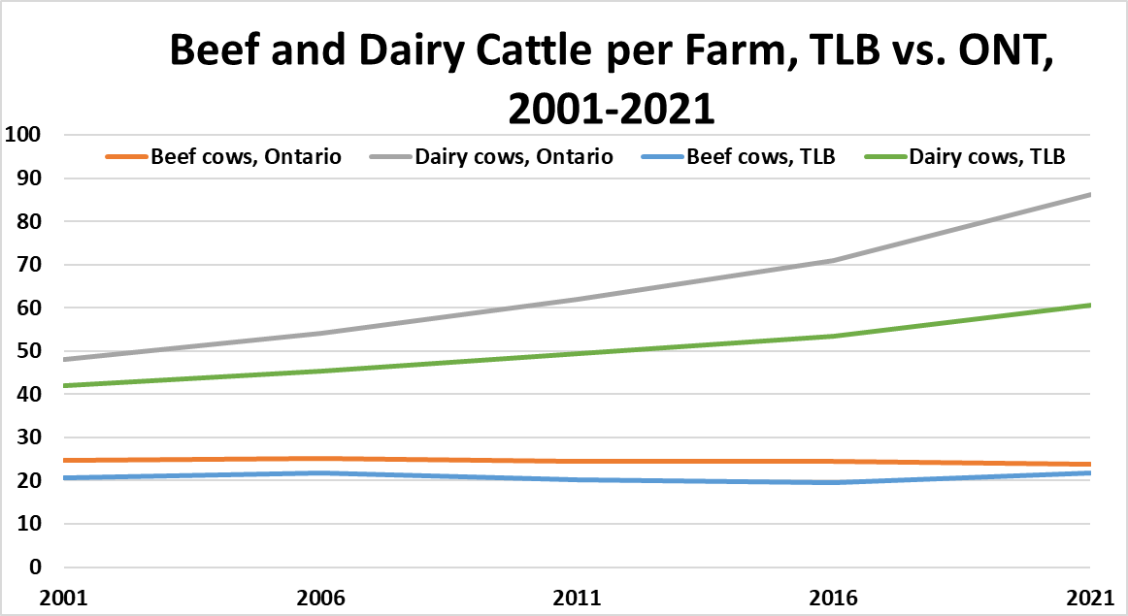
Cattle

Slide 35
Cattle
Significant decline in the number of cattle in ONT and TLB (2001-2021).
Beef herd: 40% decline in Ontario and 30% in TLB.
Dairy cows: 10% decline compared to 26.3% in TLB
Despite losing 1,085 farms w/cattle over the last 15 years, TLB was still home to 2,056 farms (out of 16500 in Ontario) and over 122,000 head of cattle in 2021
KL and Trent Hills most beef
Some growth (2016-2021) in 8 TLB regions, led by Severn with 25, Centre Hastings with 12 and Trent Lakes with an increase of 8 farms

Slide 36
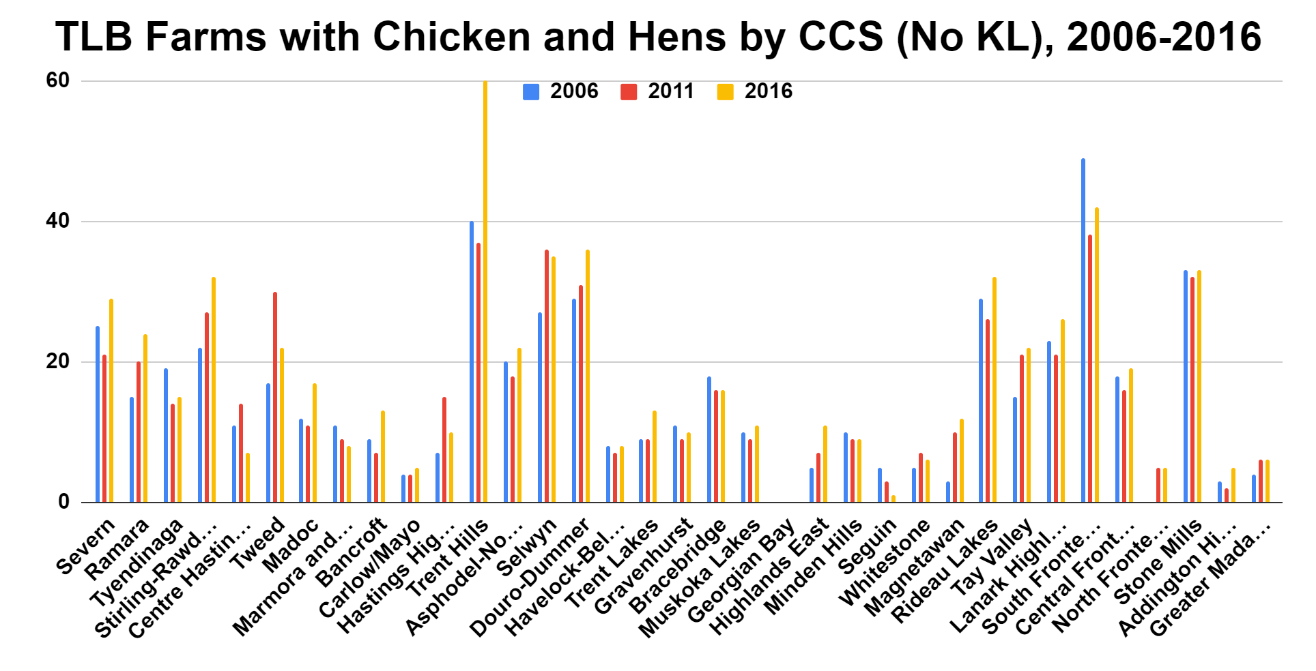
Poultry

Slide 37
Poultry
TLB decreased by over 100 farms with chickens or hens from 2016 to 2021, which accounts for over 50% of the total ONT decrease for that time less farms more birds per farm
KL, Asphodel-Norwood and Trent Hills had the largest disclosed flock total in TLB for 2016 (in that order).
Severn gained more than twice as many new farms with chickens/hens and farms with table eggs for sale as any other TLB region from 2016-2021

Slide 38
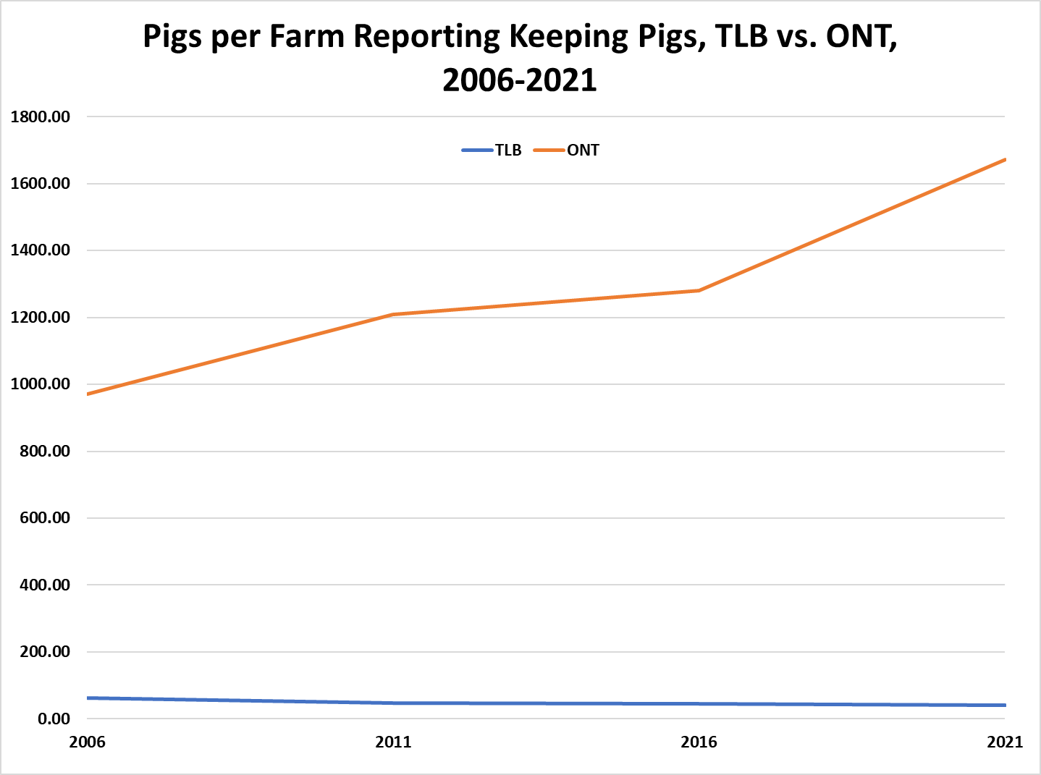
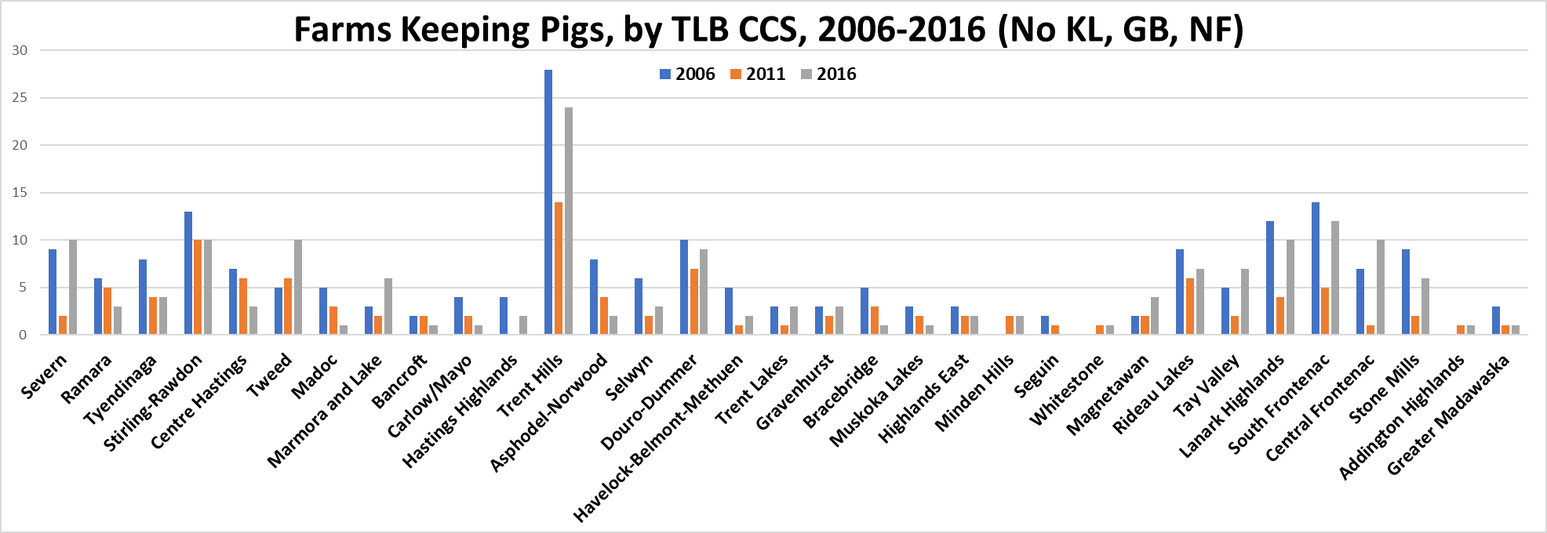
Pigs

Slide 39
Pigs
Number of pigs, and farms with pigs are declining in ONT, and in TLB. ONT has dropped by 1633 farms with pigs from 2006 to 2021, while TLB lost 105 over the same period.
KL home to 50% of TLB’s 6,488 pigs in 2021 (down from approx. 60% of 9,408 pigs in 2016).
Bracebridge and Carlow/Mayo each gained 3 farms w/pigs between 2016 and 2021, along with 2 additional farms with pigs in: Bancroft, Asphodel-Norwood, Seguin and North Frontenac.
Other than the 32 in KL, the most farms with pigs in TLB for 2021 could be found in Trent Hills (12), C. Frontenac (10) and N. Frontenac/Severn (9 each).

Slide 40
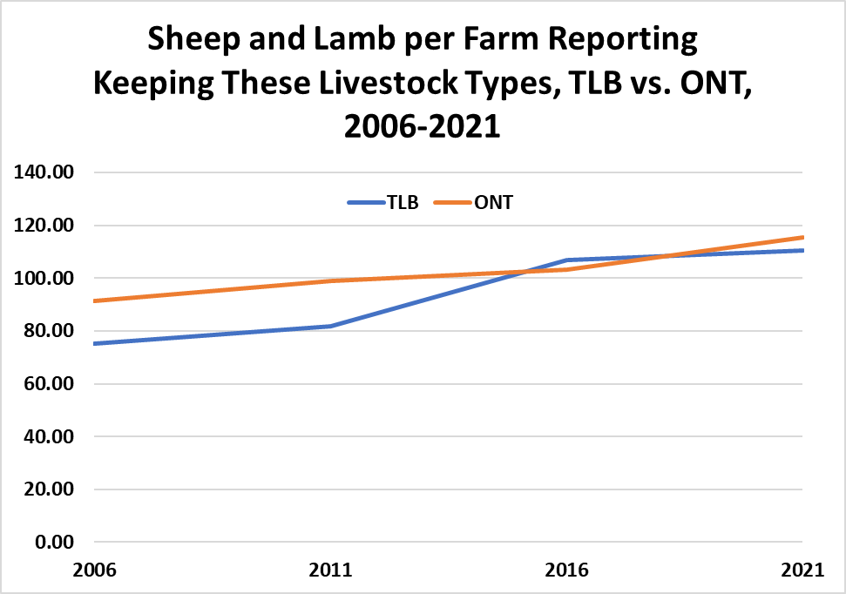
Sheep and Lambs
ONT and TLB decreasing in number of farms with sheep and lambs but increasing in the total number of sheep and lamb
In the last 15 years, TLB decreasing by 119 farms keeping sheep/lambs (from 409 to 290)

Slide 41
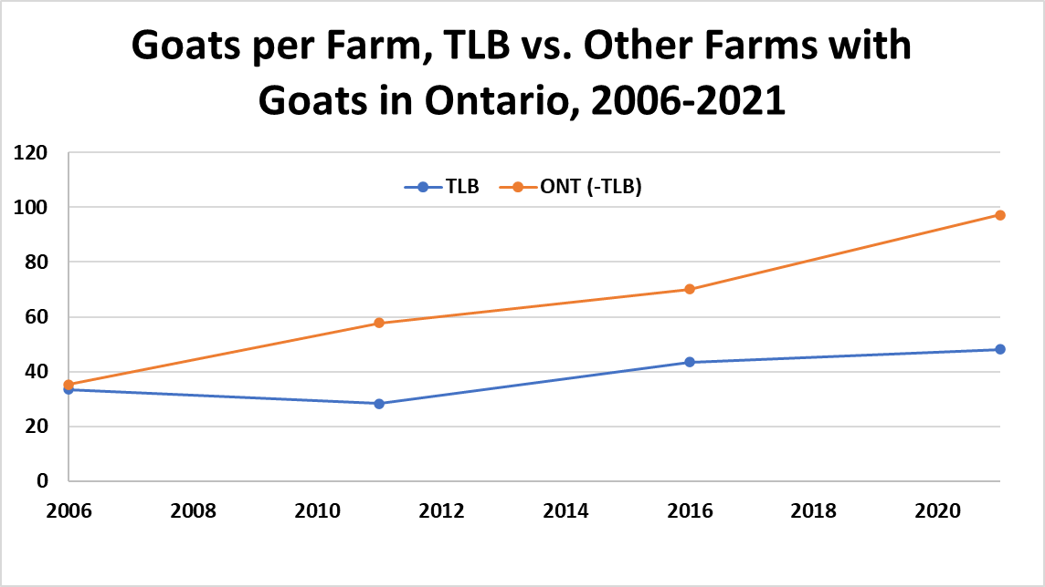
Other Livestock
The number of farms w/goats in TLB has been steadily declining, from 258 in 2006, to 173 in 2021.
57 of those 173 TLB farms w/goats in 2021 were in KL, followed by 11 in S. Frontenac and 9 each in Tweed and Douro-Dummer.

Slide 42
Other Livestock
TLB declined by over 50% of its 2016 total for farms w/rabbits by 2021. KL still had the most farms w/rabbits, even though they dropped 21 farms (from 37 to 16) between 2016 and 2021.
In terms of numbers of rabbits kept on-farm, TLB grew its total over 14 times between 2016 and 2021, from 1,145 to 15,968

Slide 43
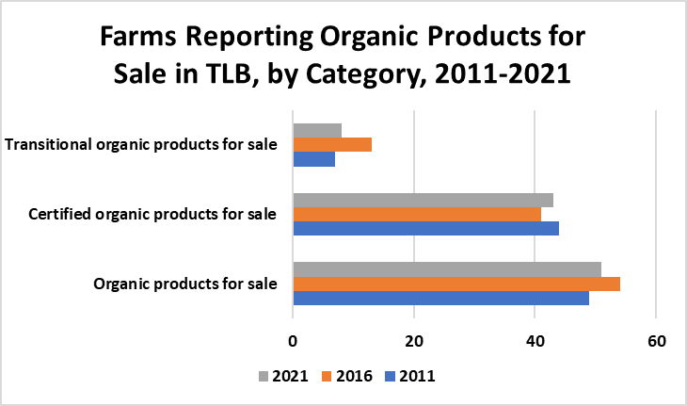
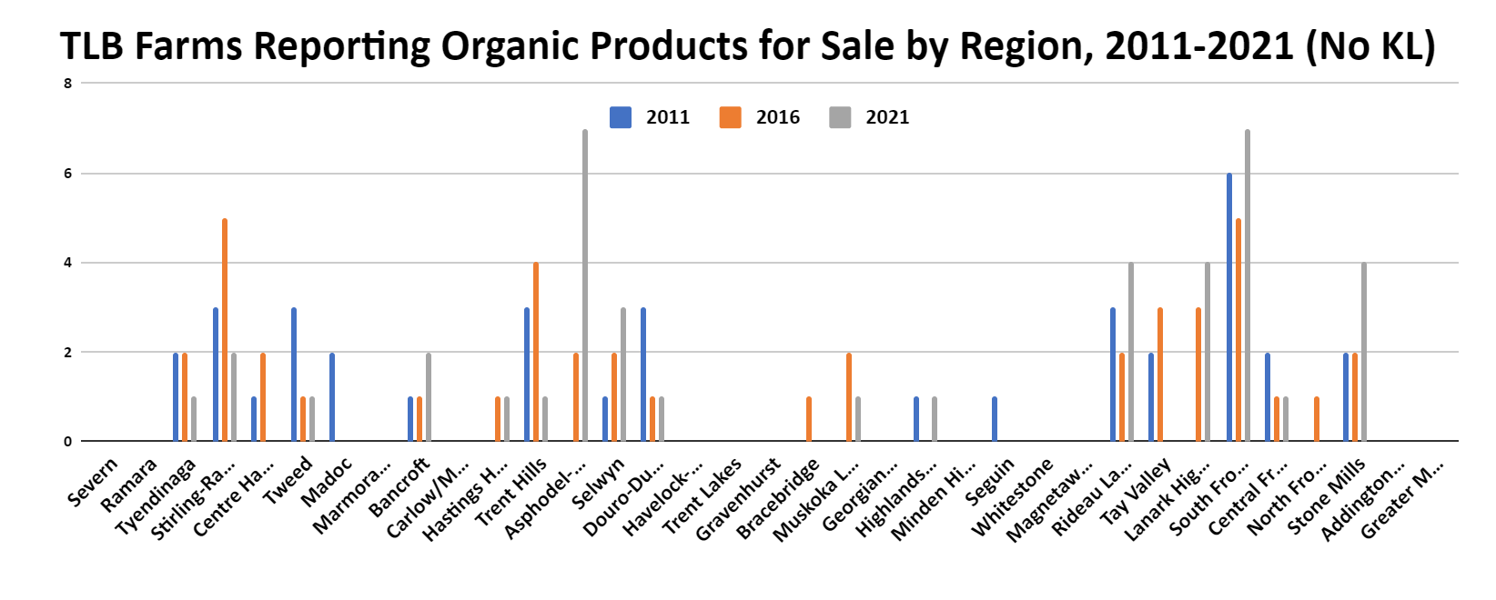
Organics Production

Slide 44
Organics Production
TLB: from 2011-2021 there was a slight decrease in the amount of certified organic production, but these numbers are still greater than 2016.
For organic production there has been a slight increase between 2011-2021, but these numbers are lower than 2016
2021 increases: Bancroft, Asphodel-Norwood, Selwyn, Rideau lakes, Lanark Highlands, S. Frontenac and Stone Mills
2021 decreases: Ramara, Tyendinaga, Central Hastings, Tweed, Madoc, Trent Hills, Douro-Dummer, Bracebridge, Muskoka Lakes, Tay Valley, C. Frontenac and N. Frontenac
2021 19 of 36 did not have any organics for sale

Slide 45
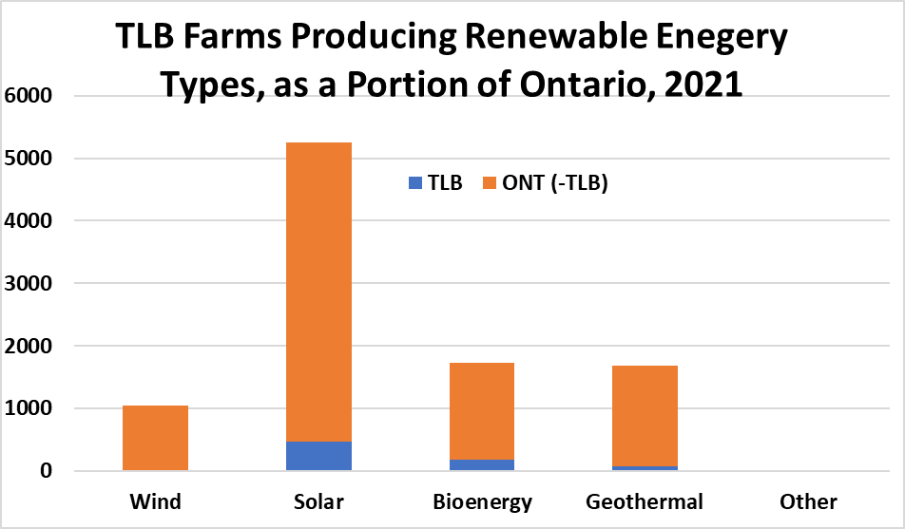
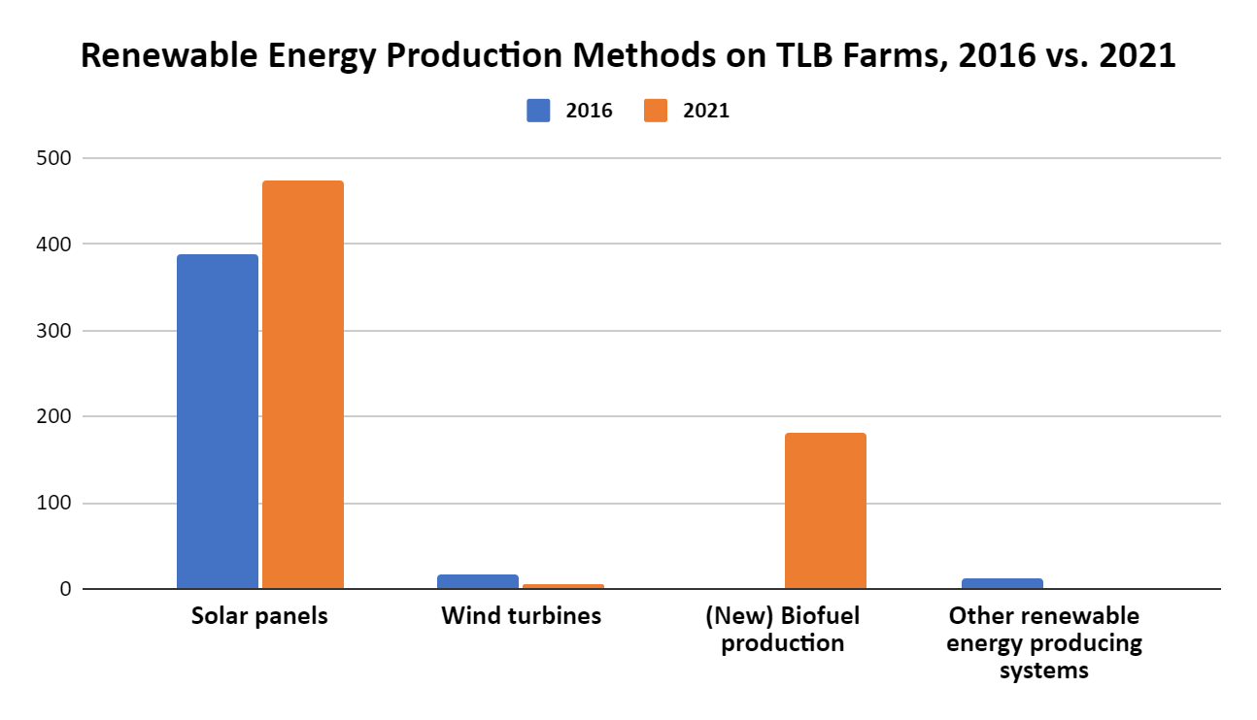
Renewable Energy

Slide 46
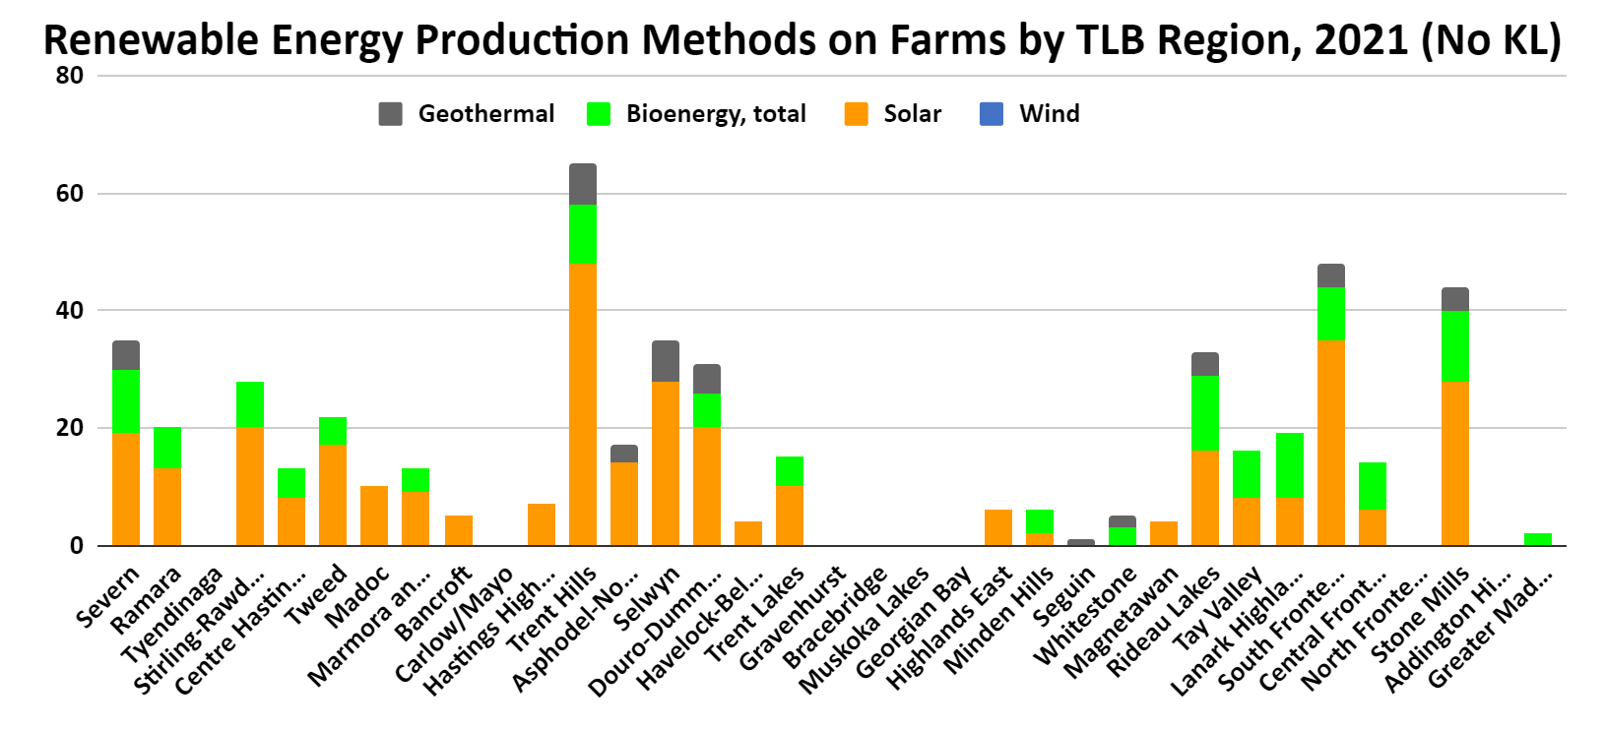
Renewable Energy

Slide 47
Renewable Energy
In 2021, TLB totaled 683 farms reporting renewable energy production, or 8.05% of the 8,483 farms reporting renewables in Ontario
The most farms producing renewable energy in TLB are doing so via solar (473 farms in 2021, up from 387 farms in 2016)
The second most common renewable energy type on TLB farms in 2016 was wind at 16 farms, but by 2021, only 5 farms remained in TLB with wind turbines
The newly added to the census category of biofuel is now the second most common method of renewable energy generation on TLB farms, specifically biomass combustion, at 173 farms.
In 2021 and 2016, Addington Highlands and Carlow/Mayo were the only TLB CCS’ with no farms producing renewable energy

Slide 48
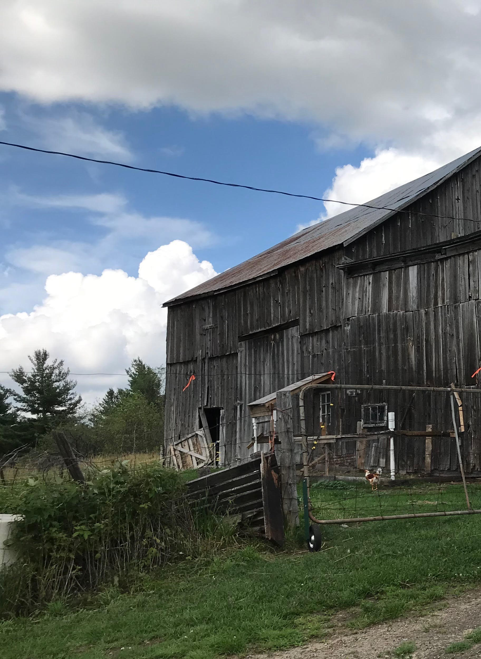
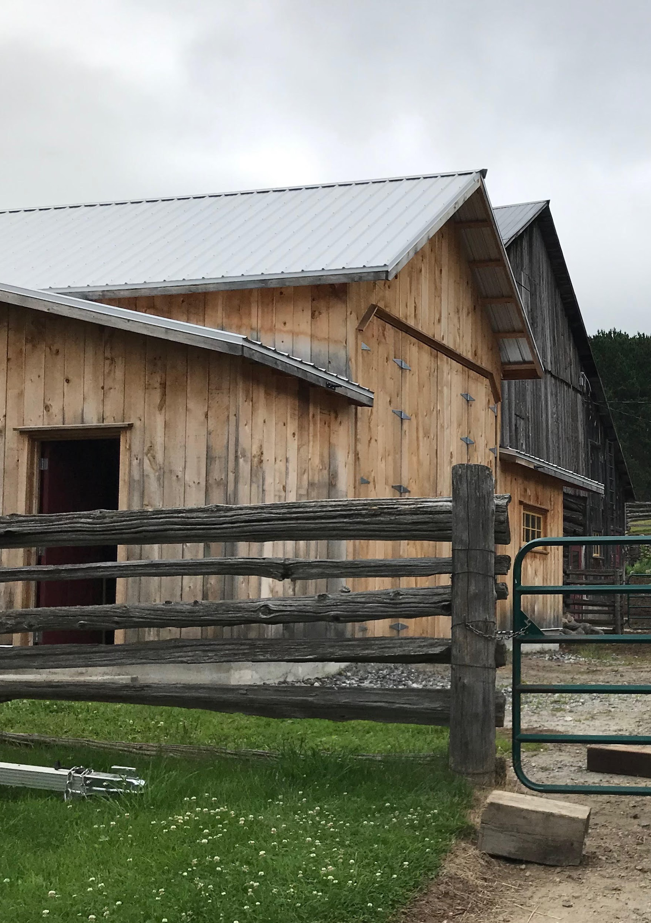
Farms of TLB

Slide 49
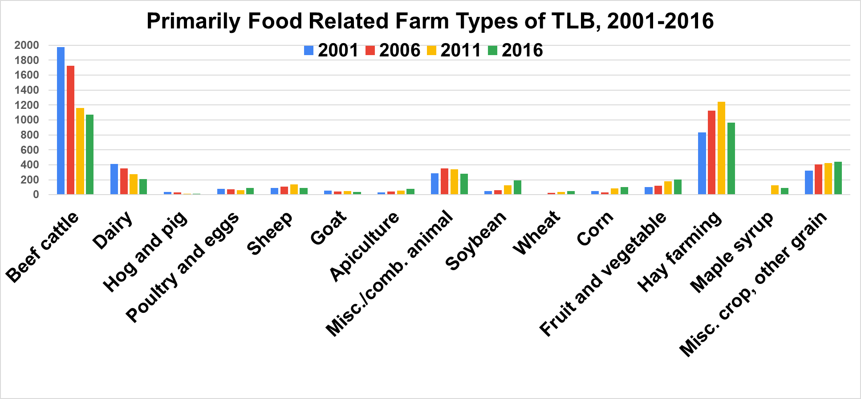
Farm Types

Slide 50
Farm Types
the most significant changes have been seen in beef cattle, second more significant decrease is in dairy
there have been increases in farms producing cash crops

Slide 51
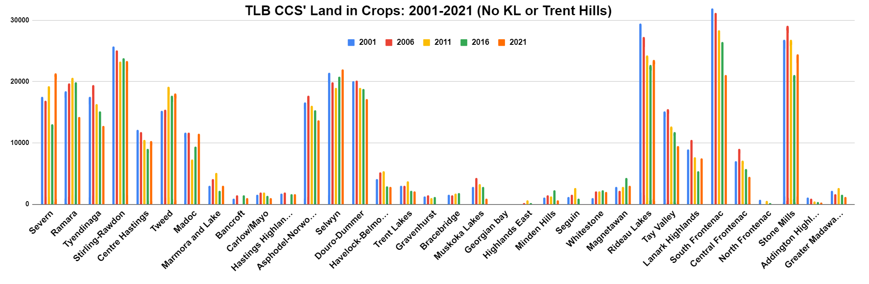
Land Use

Slide 52
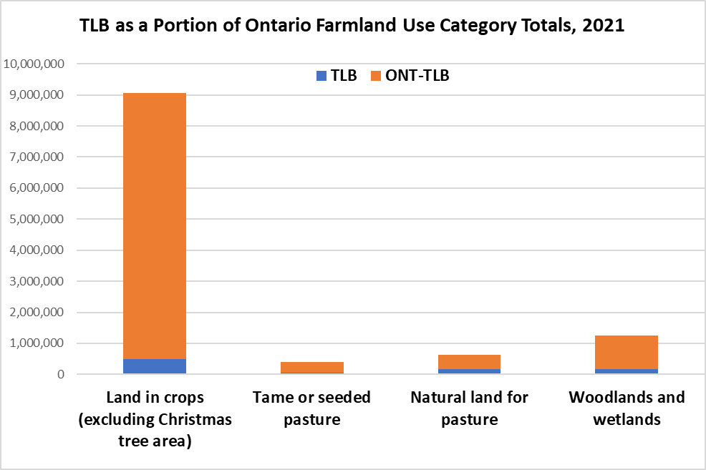
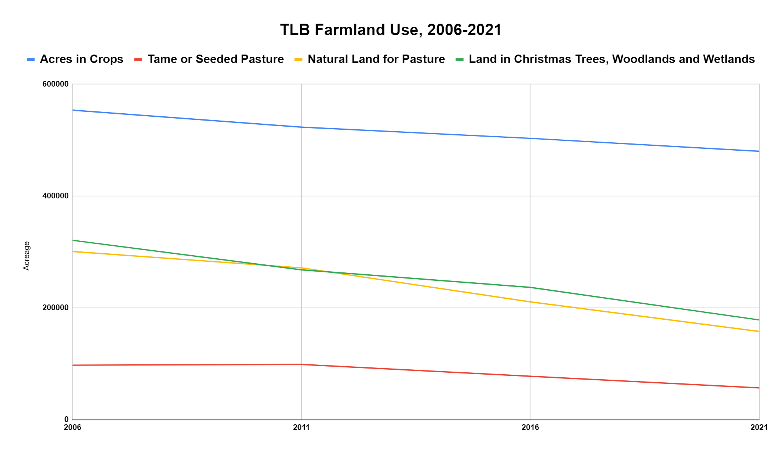
Land Use

Slide 53
Land Use
most CCS have seen a decrease in cropped landed except Severn, Tweed, and Selwyn
eastern TLB is losing more farmland than western (maybe more development there? more cottages?)
TLB farmland hosts a significant portion of Ontario’s farmland reported as woodlands and wetlands in 2021 (14.05%), down from 17.3% in 2006
As of 2021, TLB was home to just over 480,000 acres of land in crops, or 5.31% of the province’s over 9 million total acres of land in crops. TLB’s total in this category has decreased over the last three census periods, dropping a total of over 70,000 acres (-14%, or nearly 53,000 football fields)
Tame or seeded pasture, and natural land for pasture are both on the decline in Ontario and TLB specifically. Combining those two pasture types, TLB has decreased by nearly 184,000 acres from 2006-2021 (ONT down 734,000 total)

Slide 54
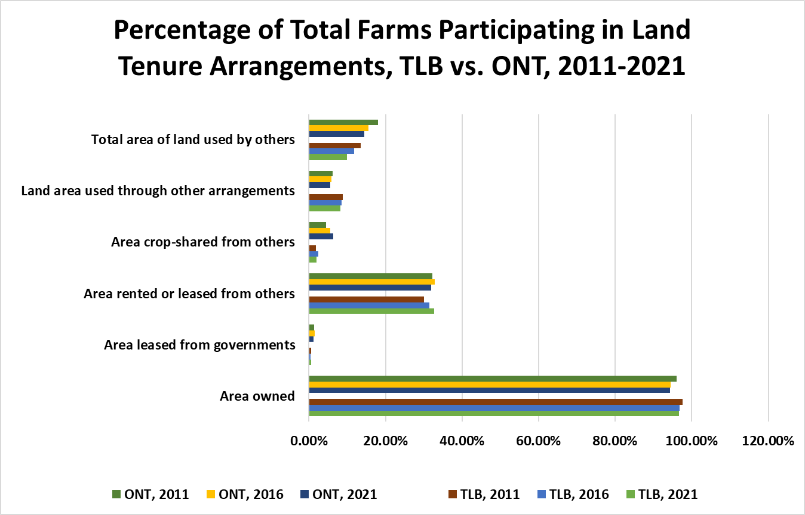
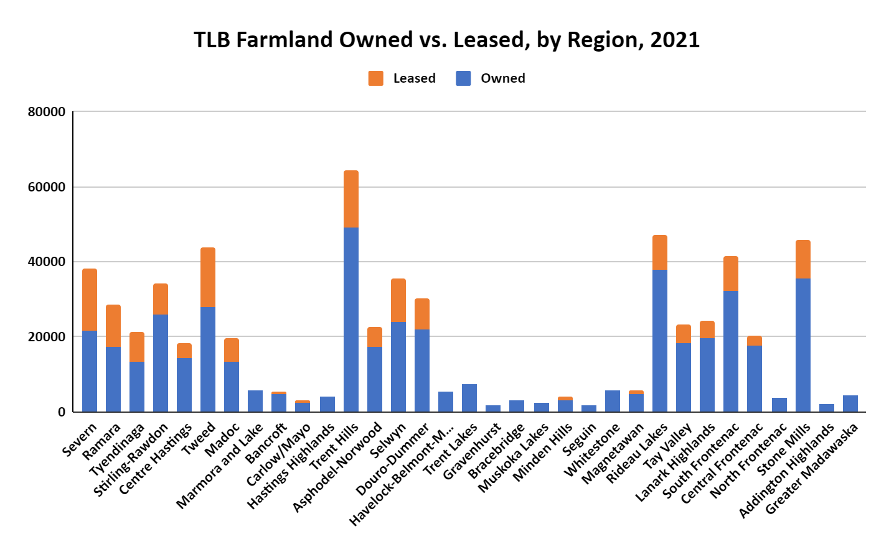
Land Tenure

Slide 55
Land Tenure
TLB has similar portions of farmland ownership as the rest of Ontario
however area rented or leased has increased since 2011
In TLB, the only farmland tenure arrangement to see growth over the most recent census period was “area leased from government”, which increased by 6 farms and just over 1,200 acres.
Every other type of farmland tenure arrangement decreased between 2011 and 2016, and 2016 and 2021, for both TLB and Ontario
In 2021, 7.83% of Ontario’s 11,766,000 plus acres are found in TLB, down from 8.75% of Ontario’s more than 12,000,000 acres in 2016
Hastings Highland, North Frontenac and Addington Highlands remain at over 93% in terms of farmland owned by operators in 2021, and the other 30 TLB regions fall between 64% and 89% for farmland owned by operators in 2021.

Slide 56
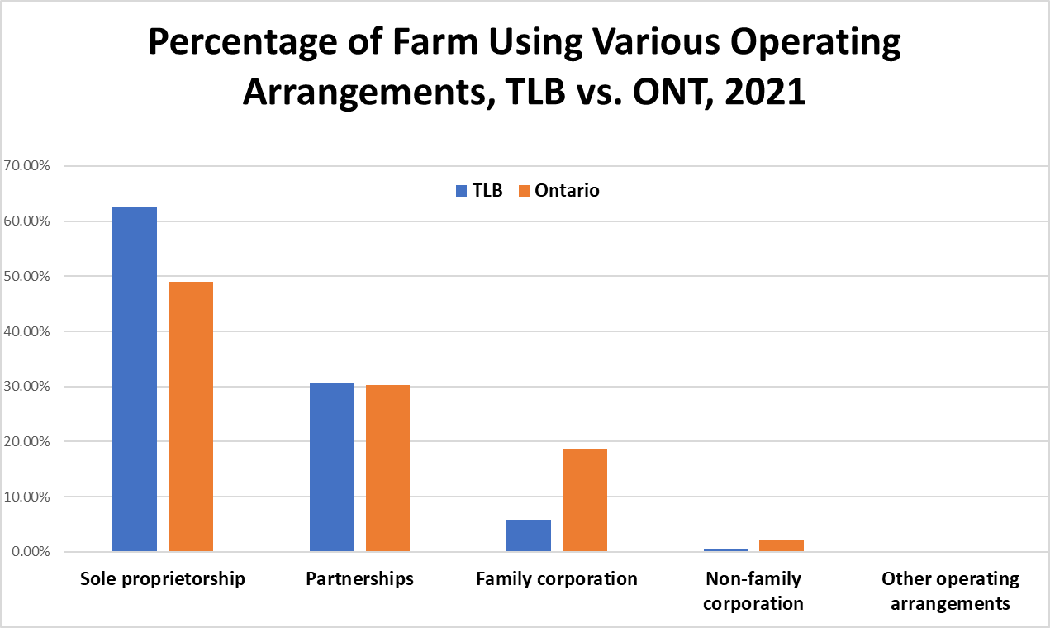
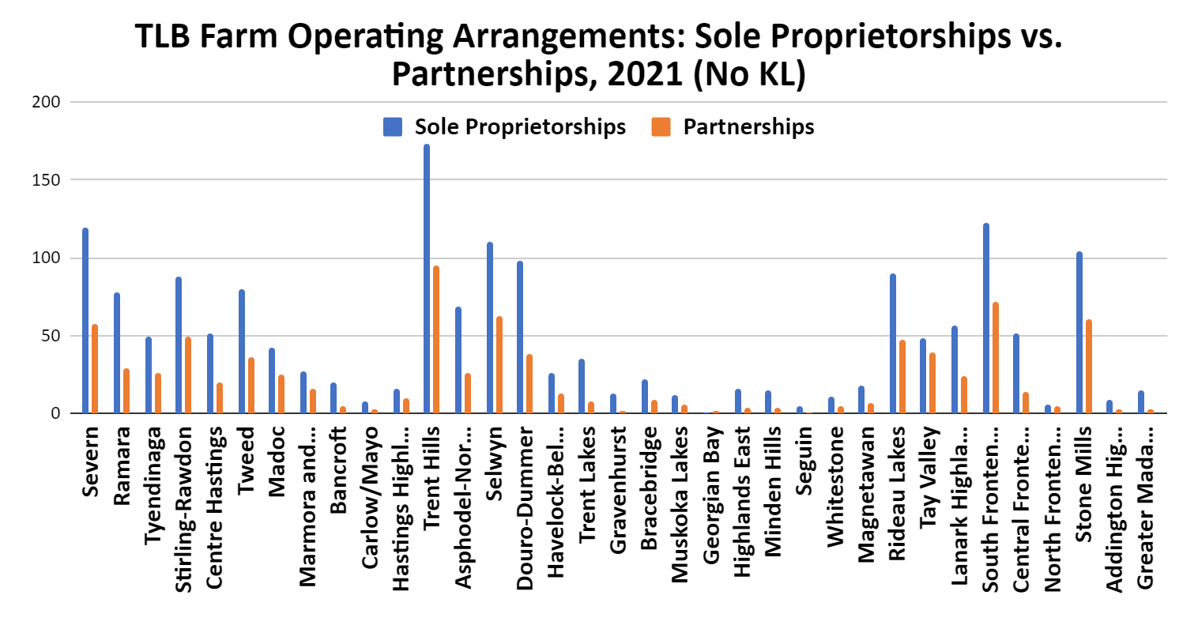
Operating Arrangement

Slide 57
Operating Arrangement
sole proprietorship much more common and family corporations much less common in TLB vs. ONT in 2021 (maybe due to the smaller average farm size)
partnerships just as common as the rest of province in 2021, now that partnerships with and without a written agreement are tracked together, as opposed to 2016
As of 2021, TLB has 2,410 sole proprietorship farms and 1,104 farms operating based on partnerships. While these categories are all down from their 2006 totals, those decreases are relatively in line with trends for the province overall
TLB has just 3 regions that have increased in sole proprietorships from 2006 to 2021, being N. Frontenac (+3), along with Georgian Bay/Marmora and Lake (+1)
KL had by far the most sole proprietorship farms in TLB as of 2021, at 707, compared to the next highest total of 173 in Trent Hills
17 of the 36 TLB regions had at least 20 partnership farms reported in 2021, all regions had at least 2

Slide 58
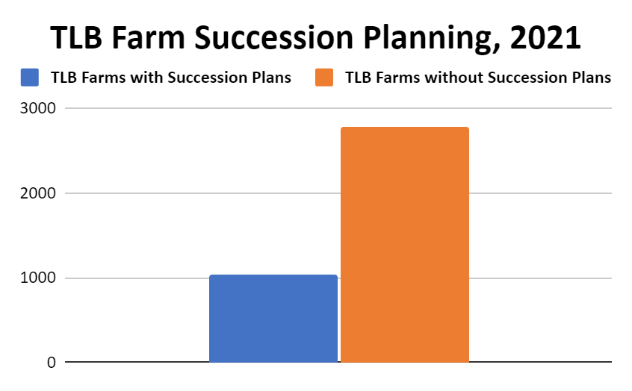
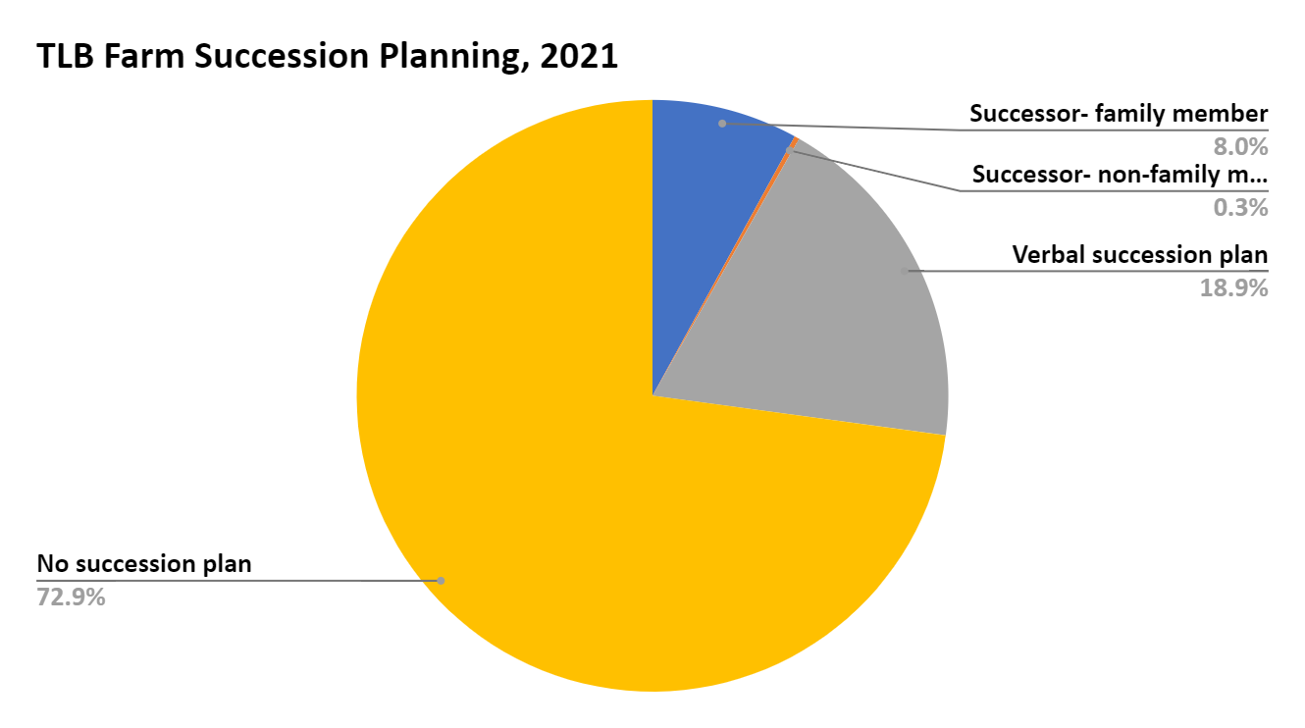
Succession Planning

Slide 59
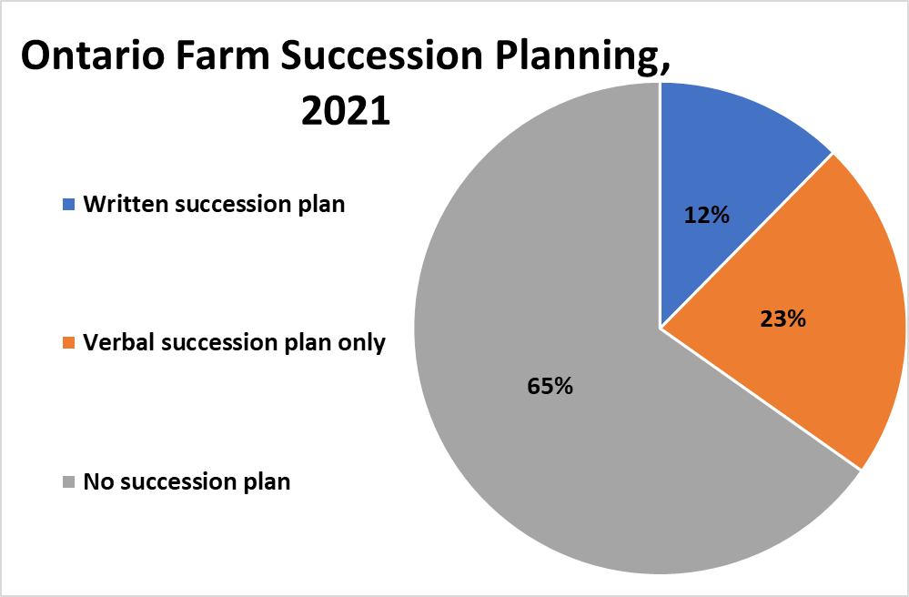

Succession Planning

Slide 60
Succession Planning
72% of farms in TLB had no succession planning in 2021, vs. 65% for ONT overall
In 2016, 6 farms in Kawartha Lakes had a non-family successor planned, with no more than 1 in any other TLB region
In 2016, the only TLB regions with greater than 10% of its’ farms reporting a succession plan were Highlands East, Seguin and Whitestone. Things look slightly better by 2021: only 5 TLB regions had less than 20% of their farms reporting some form of succession plan, now that verbal only plans have been included. 9 TLB region had >30% of their farms reporting a succession plan in 2021
No farms in these TLB regions reported succession plans in 2016: Marmora and Lake, Carlow/Mayo, Havelock-Belmont-Methuen, North Frontenac, Addington Highlands and Greater Madawaska. By 2021 and with the inclusion of verbal succession plans, only Addington Highlands, among TLB regions, had none of its farms reporting a succession plan (out of 13 total farms).

Slide 61

Direct Marketing

Slide 62

Direct Marketing

Slide 63
Direct Marketing
Of the 3,845 farms in TLB as of 2021, 887 (23%) report some direct sales (compared to 21% in 2016). 599 farms in TLB reported farm gate, stands, kiosk or u-pick sales in 2021, down from 811 in 2016.
Farmers utilizing direct sales techniques in TLB were already choosing to attend farmers markets at a lesser rate than those elsewhere in Ontario, although both regions saw similar comparative decline from 2016-2021
Portion of TLB direct sales farms selling via direct deliveries to consumers (46.22%), falls in line with the rest of Ontario, and the portion participating in CSA’s did as of 2016, however by 2021, over half of all CSA farms in TLB had stopped participating
The TLB regions with the least farms with direct sales in 2021 were: Carlow/Mayo, Seguin, N. Frontenac and G. Madawaska (each had <5 farms reporting direct sales)
Severn, Stirling-Rawdon, Trent Hills, Selwyn, KL, Rideau Lakes, Lanark Highlands, S. Frontenac and Stone Mills had at least 31 farms reporting directs sales in 2021

Slide 64


Employees On-Farm

Slide 65

Employees On-Farm

Slide 66
Employees On-Farm
TLB has declined by over 60% of its farms employing temporary or seasonal workers between 2006 and 2016, from 943 to 376, then down to 96 in 2021 (covid impact?). Whitestone was the only region to increase in farms reporting seasonal/temporary labour, gaining 1 (2006-2021)
TLB is not a significant part of Ontario’s agricultural labour market. As of the 2021 census, TLB was home to 266 farms using paid agricultural labour (down from 598 in 2016), out of 7,473 in Ontario (3.56%)
As of 2021, KL had 400 farm employees, while Severn, Trent Hills, Selwyn, Muskoka Lakes, Rideau Lakes and Stone Mills had between 93 and 131 each. Other than 67 employees in Stirling-Rawdon, no other TLB region had >30 farm employees (2021)
Part-time employees are more prevalent in TLB: as of 2021, TLB had 104 farms employing 305 part time employees, good for 3.35% and 2.95% of the respective provincial totals. Relative to ONT overall, TLB has slightly more farms w/a full time employee, but less full-time employees

Slide 67

Total Farm Capital

Slide 68

Total Farm Capital

Slide 69
Total Farm Capital
Market value of total capital per farm is on the rise across TLB: all regions increased from 2016-2021, and nearly all did between 2011-2016, except Lanark Highlands, Addington Highlands and Seguin
Total farm capital is a value measure which takes into account the current market value of all capital assets for a farming operation. Capital assets for farming operations include things such as farmland, buildings, large equipment and livestock
N. Frontenac and Greater Madawaska were the regions to see the smallest increase, growing by approximately $111,000 and $61,000 respectively, while all other TLB regions gained at least $212,000 in market value of total capital per farm (2016-21)
Trent Hills led the way with over $1,073,000 in market value growth for total capital value per farm (2016-2021), followed by Bracebridge at over $997,000 per farm, and Asphodel-Norwood at approximately $913,000 per farm. Only Tweed (+$855,619) gained more than approx. $625,000 from 2011-2016

Slide 70


Gross Farm Receipts

Slide 71

Gross Farm Receipts

Slide 72
Gross Farm Receipts
Data not available for this category for 2021
2016: Madoc, Hastings Highland, Bancroft and Central Frontenac were similarly oriented towards a regional farming profile which included more farms in the smaller gross receipt categories, with few farms in the large receipt total categories
Centre Hastings was the one region to have a comparatively smaller numbers of farms making less than $25,000, juxtaposed by a larger number of farms spread throughout the higher gross farm receipt total categories
Trent Hills second to KL for most farms in many of the gross farm receipt categories, top 2 followed by significant grouping that had farms placed across almost all gross receipt categories (other than in some cases the $1-$2 million+ categories): Severn, Ramara, Tyendinaga, Stirling-Rawdon, Tweed, Asp.-Norwood, Selwyn, Douro-Dummer, Rideau Lakes, Tay Valley, Lanark Highlands, S. Frontenac and Stone Mills.

Slide 73

Farm Operating Revenue

Slide 74
Farm Operating Revenue
Majority of farms in TLB had operating revenues under $25,000 for 2021 (57.3%)
Only 10% of farms in TLB had operating revenues over $250,000 for 2021. 131 were in KL, 44 in Trent Hills and 25 each in Stirling-Rawdon and Rideau Lakes. Less than 20 in all other TLB CCS.
16 of 36 TLB CCS had none of these high operating revenue farms. 14 of those CCS had less than 5 farms with operating revenues over $50,000 for 2021
Proportionally, TLB has many more farms with operating revenues between $1 and $25,000, while the rest of ONT has more farms with operating revenues over $100,000 (2021)

Slide 75


Farm Operating Expenses

Slide 76


Farm Operating Expenses

Slide 77
Farm Operating Expenses
Farm operating expenses in TLB are, on average, much lower than farm operating expenses for Ontario, or Canada at large: on average, TLB farms are spending over $238,000 less a year for operating expenses than farms in Ontario overall (2021), and that gap has been growing exponentially
7.92% of Ontario farms reporting expenses were in TLB as of 2021, and despite this, TLB accounted for only 2.57% of Ontario’s farm operating expense spending
Between 2006-2021, average operating expense for farms in Ontario grew nearly $126,000 more than growth in average operating expense for TLB farms
The TLB region with the highest average farm operating expense is Asphodel-Norwood, at just under $180,000 in 2016, and over $187,000 in 2021 (4 CCS <$25,000 in 2021)
Stirling-Rawdon, Centre Hastings, Tweed, Kawartha Lakes, Muskoka Lakes and Stone Mills were the other TLB region w/avg farm op expenses >$150,000 in 2021
Regions w/expenses per acre of $560 or more in 2021: Asp-Norwood, Muskoka Lakes, Stirling-Rawdon, C. Hastings, Trent Hills, Selwyn, KL, Stone Mills and Ad. Highlands.

Slide 78

Total Area of Farms

Slide 79
Total Area of Farms
almost all farm categories have seen decreases since 2006 except for 1600 + acre categories which have seen small increases (is the loss in the other categories mirrored by the gain in these categories - aka are farms getting consolidated)

Slide 80


Total Area in Crops

Slide 81


Total Area in Crops

Slide 82
Total Area in Crops
Greatest change in TLB from 2006 to 2021 occurred in farms 10-69 acres, and 70-129, which combined to decline by 882 farms, from 3,020 to 2,138
Severn was the only TLB region with significant growth in farms with under 10 acres in crops from 2006 to 2016 to maintain that growth by 2021, even adding one new farm
Ramara, Tyendinaga, Trent Hills, Douro-Dummer, Tay Valley and S. Frontenac continued trends of losing multiple medium sized acreage in crops farms (decline of at least 7 farms per region between the two most recent census periods.)
TLB has gained 15 farms w/>2,000 acres of land in crops, and 2 farms w/400-1,999 acres of land in crops (2011-2021). TLB declined by 199 farms w/between 130-399 acres
TLB decreased by 13 farms with area in crops u10 acres from 2006 to 2016, (261 to 248 farms), while Ontario lost 251 of these smallest cropped acreage farms. 2016 to 2021, TLB dropped from 248 to 212 (-36, nearly 3 times the decline seen in the previous decade) and the rest of ONT declined by 690

Slide 83
Issues for lasting food security in TLB
Age of farmers in TLB
Increased from 52-58.5 over the last 20 years (Ontario’s average moved from approx. 51 to 57 years)
Significant and steady decrease in farmers ages 35-54
Stagnant/ decreasing number of young farmers (35 and under)
Lack of succession planning
27% of farmers in TLB report having a succession plan
35% of farmers in the greater province have succession plans

Slide 84
Issues for lasting food security in TLB
Decrease in the amount of land used to grow crops
over the last three census periods TLB has seen a total decrease of 14% of farmland in this category while Ontario as a whole has seen an increase
Total decrease of nearly 52938 football fields
Decrease in the number of jobs in agriculture and in number of people working on farms in TLB
68% reduction in farms using paid employees over the last 20 years in Ontario
over 50% decrease in the number in TLB of farms using seasonal workers in the last 15 years
Transition to cash crops and foods that do not require as much labour
much of horticultural products are hand picked, grain and cash crop farm are all mechanised

Slide 85
Issues for lasting food security in TLB
Land access: Only 2.6% of Ontario farms reporting area-crop shared from others are found in TLB (down from 3.85% in 2016), and that makes up only 0.87% of the province’s total reported acreage crop-shared.
TLB does have a significant portion (15.8%) of ONT farmland “used through other arrangements (such as land-trading, or provided rent-free)
TLB has declined by 268 farms w/area used by others from 2011-2021 (384 rem.)
Bancroft, Hastings Highlands, Trent Lakes, Lanark Highlands, C. Frontenac, N. Frontenac rented out <11% of farmland (2016). 2021: all regions w/disclosed totals above 11%, other than 3 at 0%: G. Bay, N. Frontenac and Ad. Highlands
Market value of avg TLB farm total capital has grown over $1mil in a decade (2011-21)
Avg op. expense for TLB farm up >100% (2006-2021), approx. $52,000 to $114,700
Average operating expense per acre has increased from $249 to $459, 2011-2021

Slide 86
Issues for lasting food security in TLB
Market access challenges: Low volume of direct sales
direct sales more likely to ensure that food stays local, and allows producer to maximize the value of any specialized practices used to produce that good
In TLB only 23% of farms have direct sales and in the rest of Ontario, just 15.3%
Farmers markets proposed as solution, but in current day context challenges related to cost, accessibility, km restrictions on sellers, and facilities reduce benefit of this strategy
Bancroft, Carlow/Mayo, Gravenhurst, Seguin, Magnetawan, N. Frontenac and Ad. Highlands had no farms reporting selling at farmers’ markets in 2021
In 2016, only 165 TLB farms reported sales at farmers markets, which is 18.4% of TLB farms with direct sales, whereas for ONT overall, >22% of farms with direct sales report using farmers markets. In 2021, % of direct sales farms reporting selling at farmers markets dropped to 10.7% for TLB, and 15.6% in ONT

Slide 87
Issues for lasting food security in TLB
Large decrease in agricultural operations less than 399 acres, especially farms 10-129 acres
TLB home to 8.5% of ONT’s greenhouses growing vegetables in 2021 (lots of room for growth). Farms w/greenhouse veg are increasing: TLB total 46 in 2006, vs. 64 in 2021
2006-2011 and 2011-2016: increase in number of farms reporting growing vegetables (+53 and +22) however this turned into a decrease in the number of farms reporting vegetable growth between 2016-2021 (-61), 2021 TLB total= 259 farms w/vegetable crops
123 farms reported fruit crops (2021), down from 142 in 2011, but up from 110 in 2006
Total land in crops declined from 551,456 acres in 2006, to 480,322 in 2021 (-12.9%)
Cash crop acreage grew over 74% from 2006-2021, and the 2021 total of approx. 199,000 acres is actually down over 34,500 acres from the 2016 high of nearly 234,000 acres
These declines come at a time when Ontario’s population is expected to grow by upwards of 175,000 people per year, and has already grown by an avg of 1.16%/year the last 20yrs

Slide 88
Addressing food security in TLB with climate change
Nature based solutions
Agroecology
Intercropping, diverse cropping
Focus on community food security
Preserving the significant portion of wetlands that TLB farmer protect
Changes in the size of equipment
Longer growing season, with more heat units overall, but greater volatility and continued risk of late frost
Practices that can adapt to increased uncertainty: Maple syrup tapping has become incredibly unpredictable, used to be reliably done on March break, now sometimes happens in February

Slide 89
Significant findings
72% of farmers in TLB do not have succession plans, vs. ONT at 65%
The farming population is aging faster than the rest of Ontario
the amount of middle aged farmers (35-54 years) has sharply declined, 2006-2021
67.8% of TLB farm operators were 55+ in 2021, avg age 59+ in 20 of 36 TLB CCS
Minden Hill and Tyendinaga had the lowest average age (<56)
89.7% of farmers in TLB lived on their farms as of 2011 (recent data not available)
55% farmers in TLB are working less than 30 hours on farm per week
TLB accounted for 75% of the provincial decline in operators working less than 20 hours per week from 2016 to 2021, and had a decline of 6 times as many operators as the province gained, from 2011 to 2016
TLB farmers are 2.8% more likely to have off-farm income than those in ONT overall
Farms with only 1 operator are more common in TLB than other parts of ONT

Slide 90
Significant findings
Increase in TLB farms w/vegetable production from 2006 to 2016 (+75), before a decline from 2016 to 2021 (-61), when 8 CCS gained farms with vegetable crops and 24 declined
Fruit crops grown on more TLB farms in 2021 than 2016 were: apples, pears, blueberries, grapes, plums and prunes. Over 40% of farms with fruit, nuts or berries in TLB had strawberries, and/or raspberries, and over 52% had apples, as of 2021
TLB vegetable farmers grow more different veggie crops per farm than the ONT average
Increase in farms with mushroom production from 2006-2021 (from 5 farms to 12), but lower than 2016 highs (18 farms)
Alfalfa production has seen significant decline (-46%) in acreage from 2006-2021, but still accounts for 13.28% of all farm area in TLB, or 26% of hay and field crop acreage
TLB natural land for pasture has declined from 360,696 acres in 2001, to 157,858 in 2021
if much of pasture land unsuitable for crops= great decrease in food production

Slide 91
Significant findings
Amount of greenhouses growing vegetables have increased: 27 in 2006, to 64 in 2021
KL has 17 farms w/greenhouse veg, most of any TLB CCS, while South Frontenac and Trent Hills have 7 each, and no other region has more than 4 (4 in both Tweed and Carlow/Mayo), as of 2021
TLB lost over 11% of farms with chickens/hens from 2016-2021; however since 2006, the number of chickens per farm has been increasing (1,752 in 2021, vs. in 692 in 2006)
Large losses in beef (-33% farms, -30% herd), dairy (-49% farms, -26% herd), 2001-2021
33% of farms in TLB were classified as beef cattle farms in 2021, down from 41% in 2001
Over the 15-year span from the 2006-2021 censuses, the difference in the average number of pigs per farm between Ontario and TLB increased from 908 to 1,629 pigs
In the last 15 years, TLB sheep and lamb farms have changed from keeping on average 16 less animals per farm compared to the province, to 5 less

Slide 92
Significant findings
TLB is seeing a decrease in land use acreage across the board, declining in: land in crops, tame and seeded pasture, natural pasture and woodland and wetlands.
TLB farmland decline: 1,215,535 acres in 2011, to 921,788 acres in 2021 (-24.16%)
Eastern TLB losing more farmland than western (more development and/or cottages?)
TLB farmland hosts a significant portion of Ontario’s farmland reported as woodlands and wetlands in 2021 (14.05%), down from 17.3% in 2006
2021: TLB was home to over 480,000 acres of land in crops, or 5.31% of the province’s over 9 mil total acres of land in crops. TLB’s total has decreased over the last 3 census periods, dropping a total of over 70,000 acres (-14%, or nearly 53,000 football fields)
2006-2021: % of farms classified as soybean farms increased in 20 of 36 TLB regions. The % of farms classified as wheat farms grew in 9 TLB regions over that time, and 19 TLB regions saw an increase in the % of their total farms classified as field corn farms

Slide 93
Significant findings
Of the 3,845 farms in TLB as of 2021, 887 (23%) report some direct sales (vs. 21% in 2016)
Total farm capital grown by >100% in most CCS. Approx. 90% of cap. value is land/buildings
Majority of TLB farms op. revenue= <$25,000 for 2021 (57.3%), 10% <$250,000
Proportionally, TLB has many more farms with op. revenues between $1 and $25,000, while the rest of ONT has more farms with op. revenues over $100,000 (2021)
TLB farms spending >$238,000/year less for op. expenses than farms in ONT overall (2021), and that gap has been growing exponentially
7.92% of ONT farms in TLB, yet only 2.57% of ONT’s farm operating expense spending
TLB farms run at a significantly lower cost per acre than farms in the rest of ONT ($1,399 vs. $459 in 2021); however costs increasing faster than inflation (2011= $249 per acre)
Sole proprietorship farms much more common and family corporations much less common in TLB vs. ONT in 2021 (maybe due to the smaller average farm size)

Slide 94
Significant findings
Greatest change in TLB from 2006 to 2021 occurred in farms 10-69 acres, and 70-129, which combined to decline by 882 farms, from 3,020 to 2,138
Great loss of small scale farms: 429 fewer farms under 130 acres or 1,081 fewer farms under 400 acres (2006 vs. 2021), 3,845 farms total in 2021.
Kawartha Lakes, Trent Hills and South Frontenac (42.6% of TLB farms in 2021)
leaders in veggie greenhouses with 17 for KL, and 7 each for Trent Hills/S. Frontenac
in 2016 these were also the TLB leaders in direct sales (S. Frontenac passed by Severn and Lanark Highlands by 2021)
leaders in farms with gross farm receipts of $50,000 or more in 2016
leaders in farms with solar panels, 2016 and 2021
Along with Selwyn, Severn and Stone Mills (182-193 farms each in 2021), these were the only TLB regions with >153 farms, combined to account for 57% of all TLB farms in 2021

Slide 95
Significant findings?
Solar is the most popular form of renewable energy on farms in TLB (473 farms in 2021)
2016-2021: TLB declined by 39 farms with honeybee colonies (205 to 166). Other parts of Ontario actually gained 7 farms reporting colonies of honeybees. From 2006-2021, 24 TLB regions saw growth in % of their total farms classified as apiculture farms
Stirling-Rawdon (15 farms), Trent Hills (33), Asphodel-Norwood (11) and Rideau Lakes (18) were the only TLB regions with more than 10% of their total farms classified as dairy
In Highlands East, Lanark Highlands and Greater Madawaska at least approximately 20% of their farms were classified as maple syrup farms in 2021
28% of all new farms with maple taps in Ontario from 2001 to 2016 came from TLB
Hay farms in TLB continue to decline, from a 2011 high of 1,244 farms, to just 643 in 2021
Farms w/rye crops in TLB grew 134% from 2016-2021, from 50 to 117 farms

Slide 96
Significant findings?
Severn and Ramara have the most rented farmland in TLB, as of 2021 (Tyendinaga 3rd)
29 (of 36) TLB census regions declined in farms from 2016 to 2021. Severn (44), Centre Hastings (16), Marmora and Lake (14), Trent Lakes (4) and Georgian Bay (3) gained farms
Madoc, Bancroft, Trent Hills, Gravenhurst, Magnetawan= TLB regions w/gain in farms, farm acreage, acreage owned (2011-2016). No region grew in all 3 of these categories from 2016-2021, and 15 TLB regions declined in all three of farms, farm acreage and acres owned. Another 9 regions could be included based on currently undisclosed data
TLB has lost over 89% of its farms employing temporary or seasonal workers between 2006 and 2021 (60% decline from 2006-2016)
Stirling-Rawdon, Trent Hills, Asphodel-Norwood, Selwyn and Rideau Lakes employee the most full, part-time and seasonal ag labour in TLB, relative to # of farms in each area (2016). Muskoka Lakes, Seguin and Whitestone on the rise by 2021

Slide 97
Significant findings?
Part-time employees are more prevalent in TLB, vs. ONT: as of 2021, TLB had 305 part time employees (2.95% of the ONT total), vs. 482 full time employees (1.97% of ONT)
2021: TLB +78 farms reporting a partnership-based operating arrangement, vs. 2016
TLB has just 3 regions that have increased in sole proprietorships from 2006 to 2021, being North Frontenac (+3), along with Georgian Bay and Marmora and Lake (+1 each)
2021: only 5 TLB regions had less than 20% of their farms reporting some form of succession plan, now that verbal only plans have been included. 9 TLB regions had greater than 30% of their farms reporting a succession plan
Addington Highlands had no farms reporting succession plans in 2021, unique in TLB
Bancroft, Carlow/Mayo, Gravenhurst, Seguin, Magnetawan, North Frontenac and Addington Highlands had no farms reporting selling at farmers’ markets in 2021
Other than G. Bay, all TLB regions had at least 2 farms w/deliveries to consumers in 2021

Slide 98
Significant findings?
Ramara, Trent Hills, Kawartha Lakes and South Frontenac declined by between approx. 4,200-5,700 acres of land in crops each (2016-2021), all on southern border of TLB
TLB accounted for 66% of Ontario’s 2016-2021 growth in farms w/between 10-69 acres
For farms 760-1,119 acres, TLB lost 30 and other parts of Ontario gained 37 (2016-2021)
Growth trend in largest acreage farms has made its way to TLB: over a quarter (26.67%) of the province’s 15 new farms >2,880 acres from 2016-2021 could be found in TLB
From 2016 to 2021, Ramara, Tyendinaga, Trent Hills, Douro-Dummer, Tay Valley and South Frontenac continued their trends of losing multiple medium sized acreage in crops farms, with a decline of at least 7 of these farms per region between the two most recent census periods
2016: only Tweed’s total farm capital market-value per farm over 1.5mil, vs. 2021=14 CCS

